Slide 1

Topseller Quick Reference Guide
Canada. | March 2025

Slide 2
Lenovo Topseller - Notebooks

Slide 3
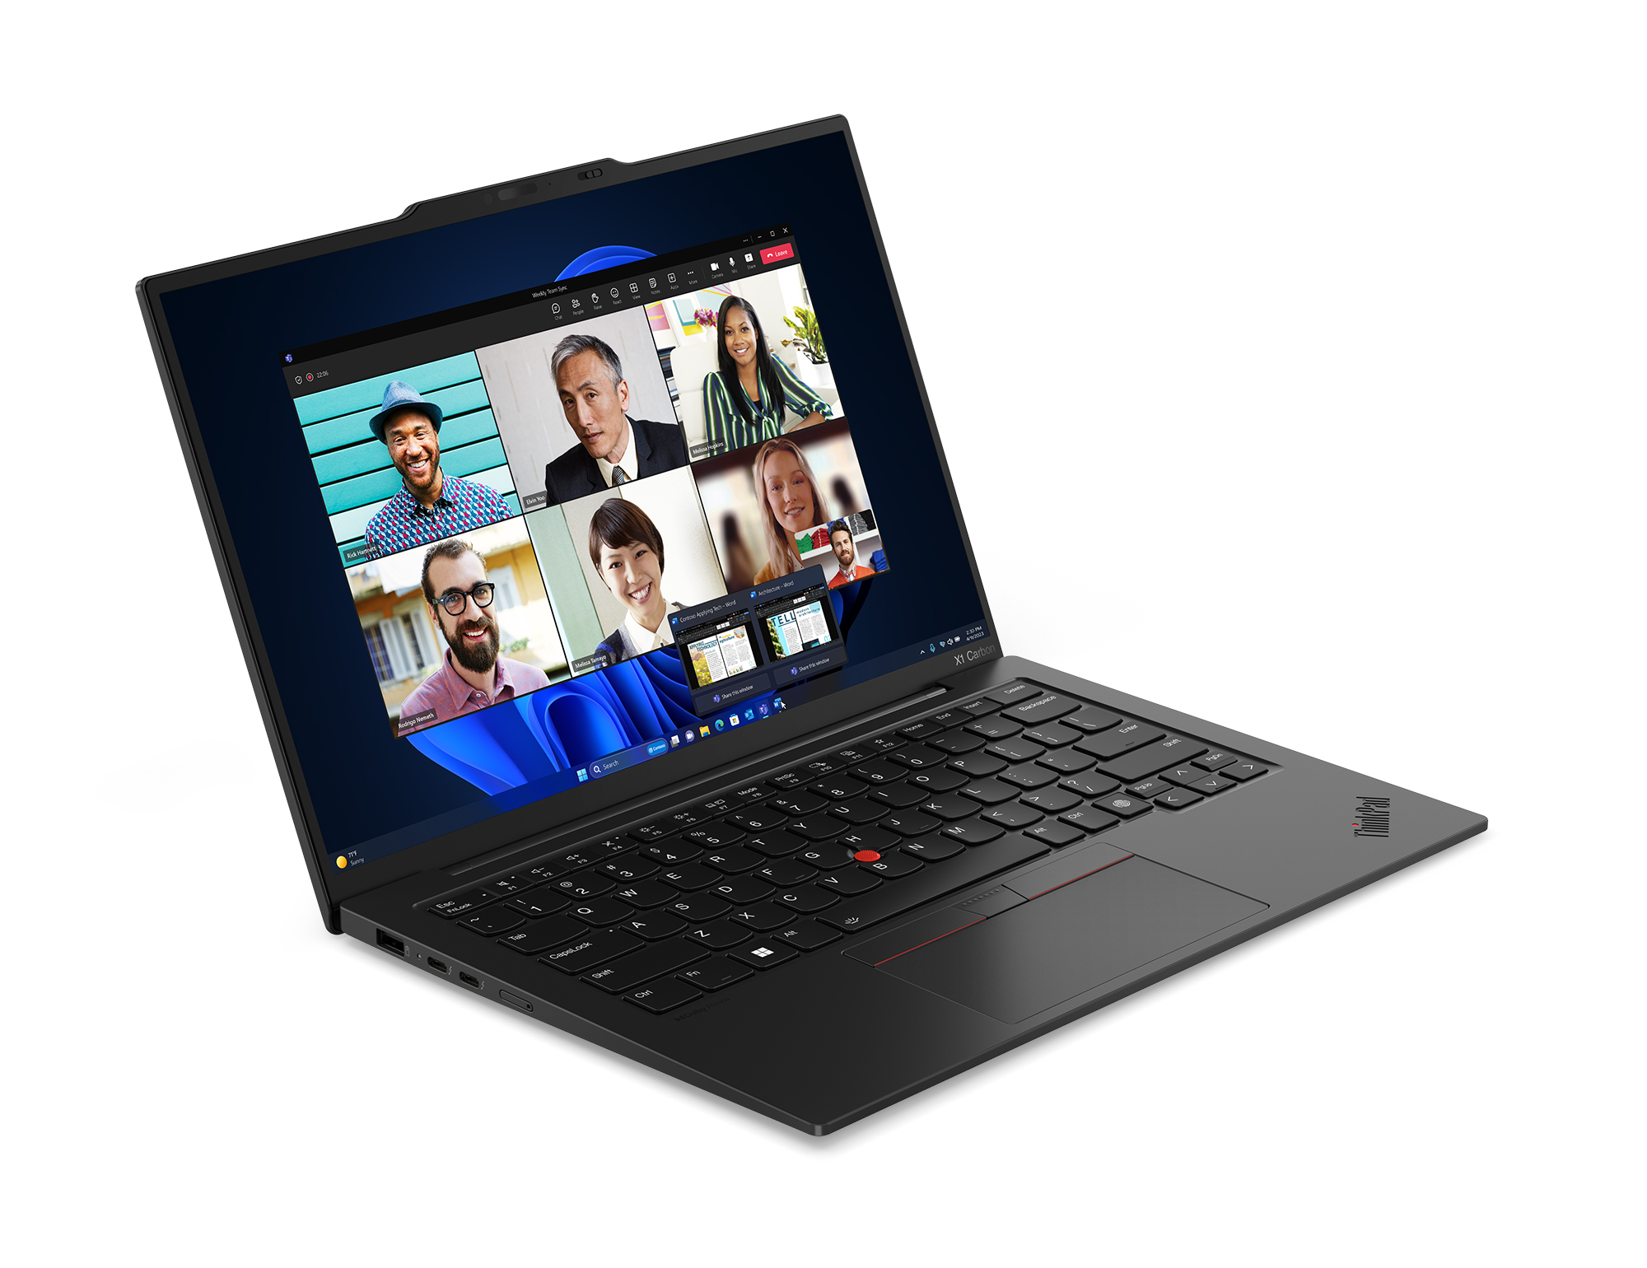
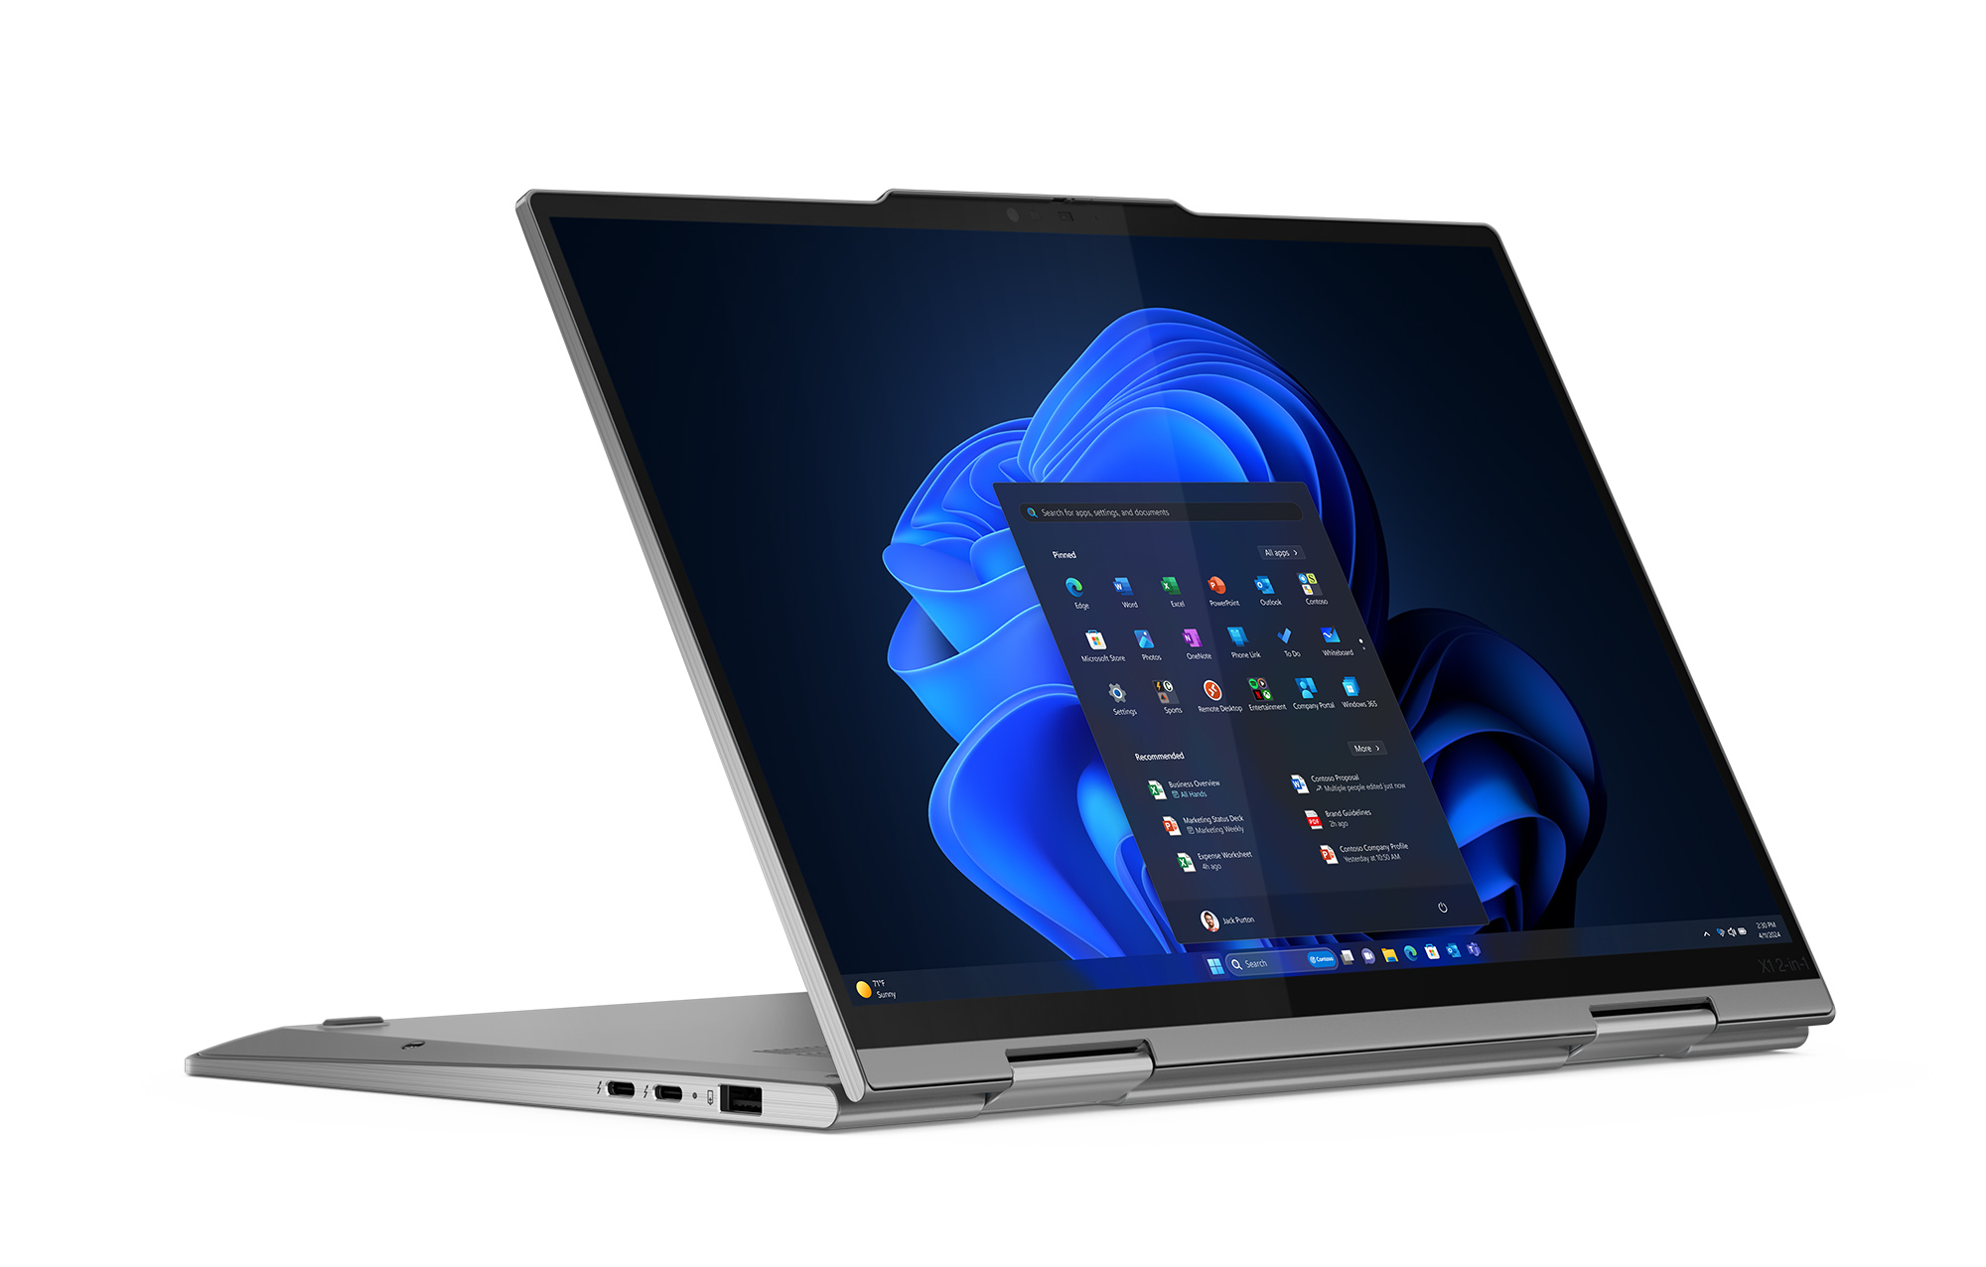
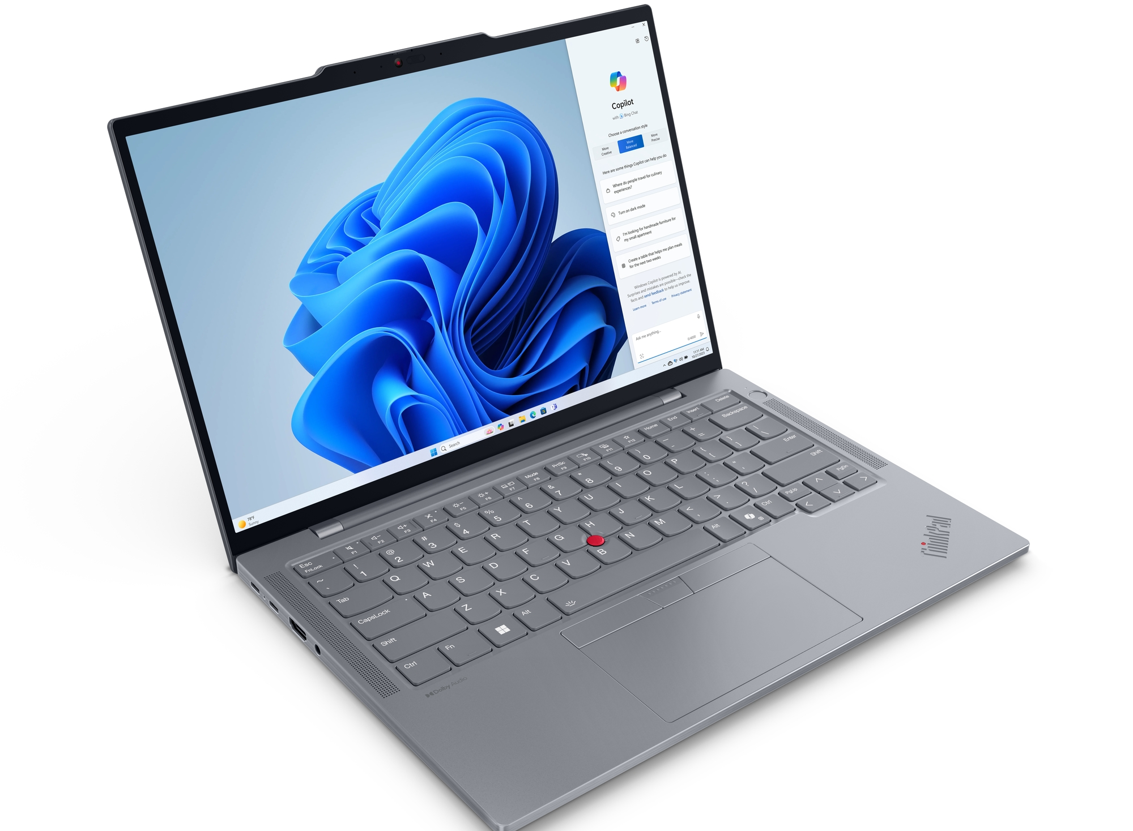
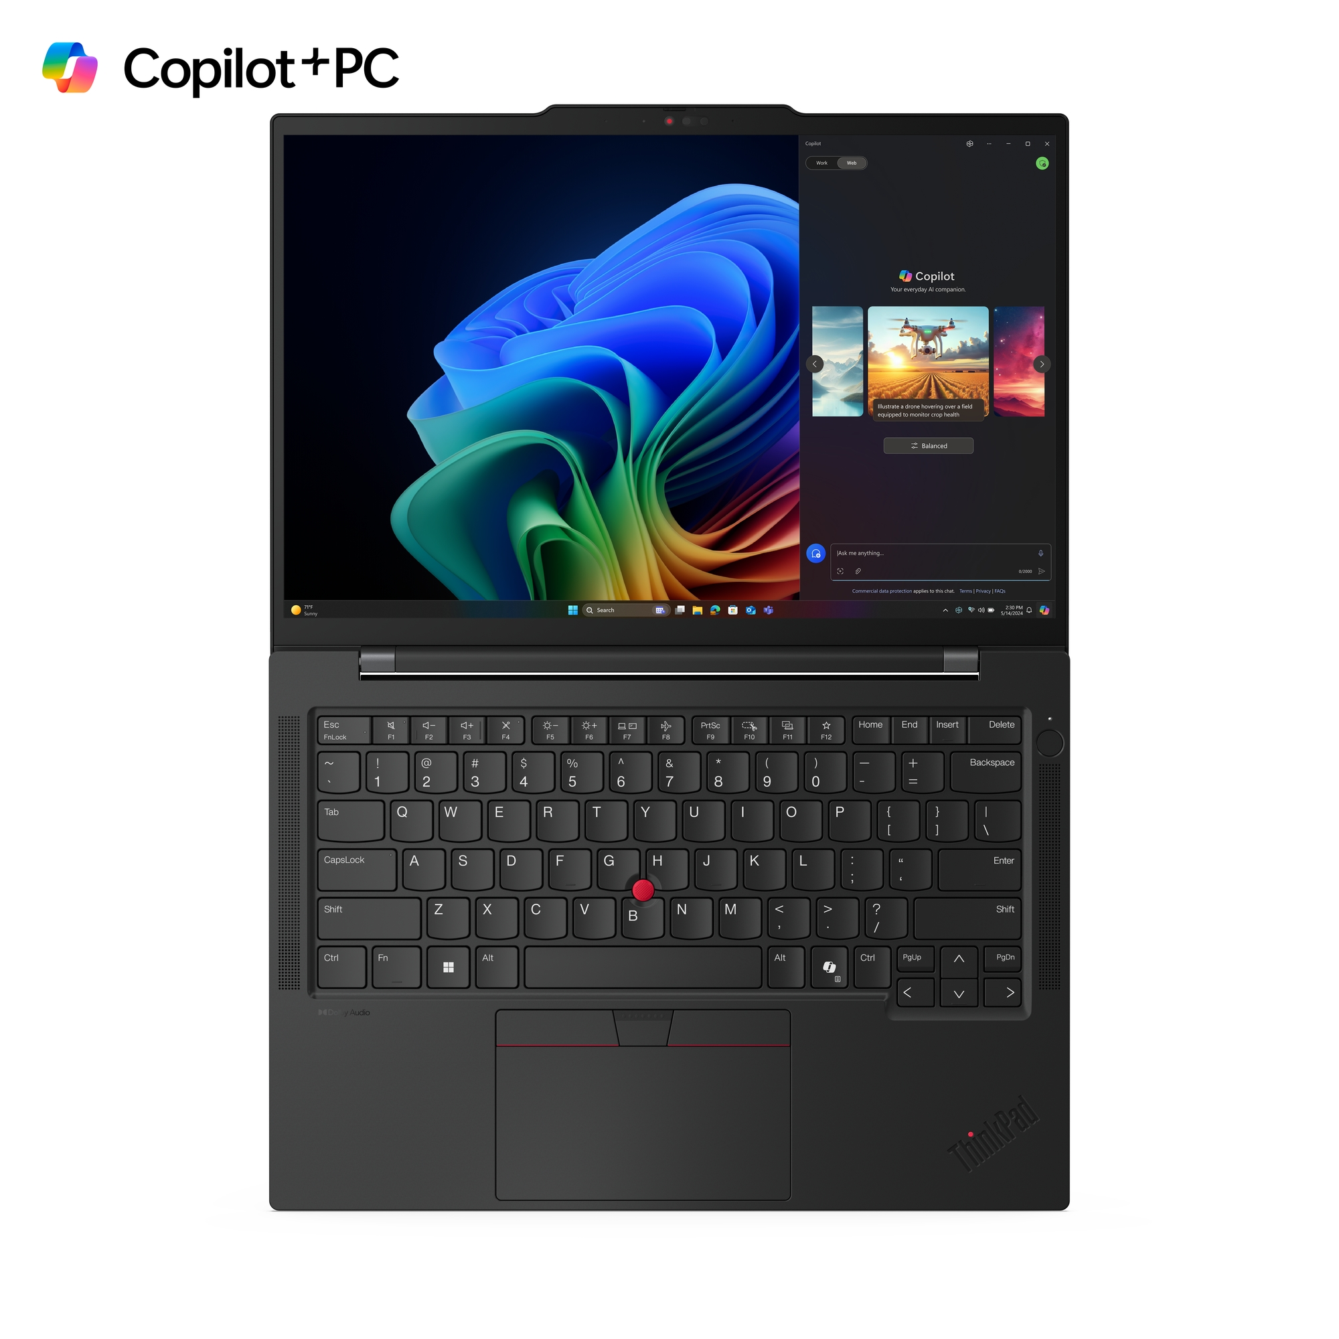
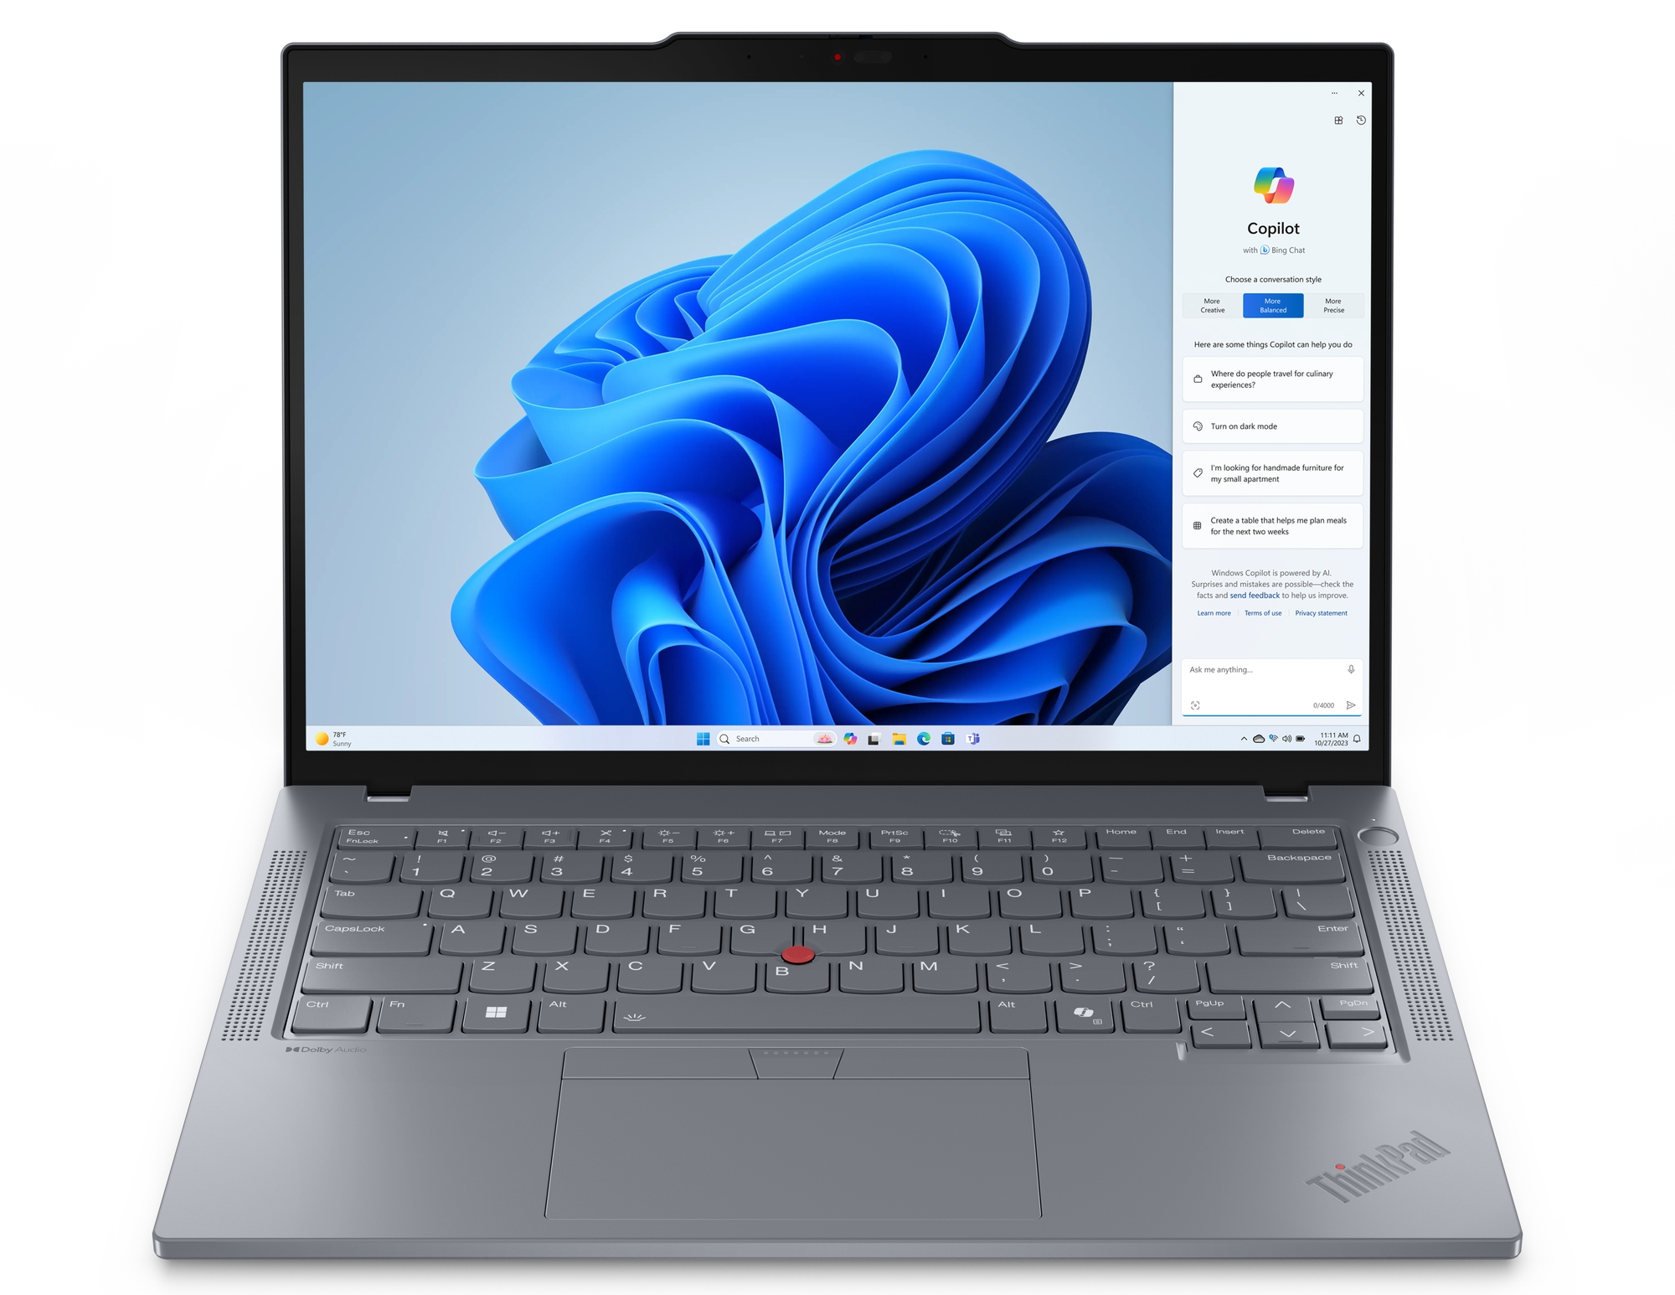
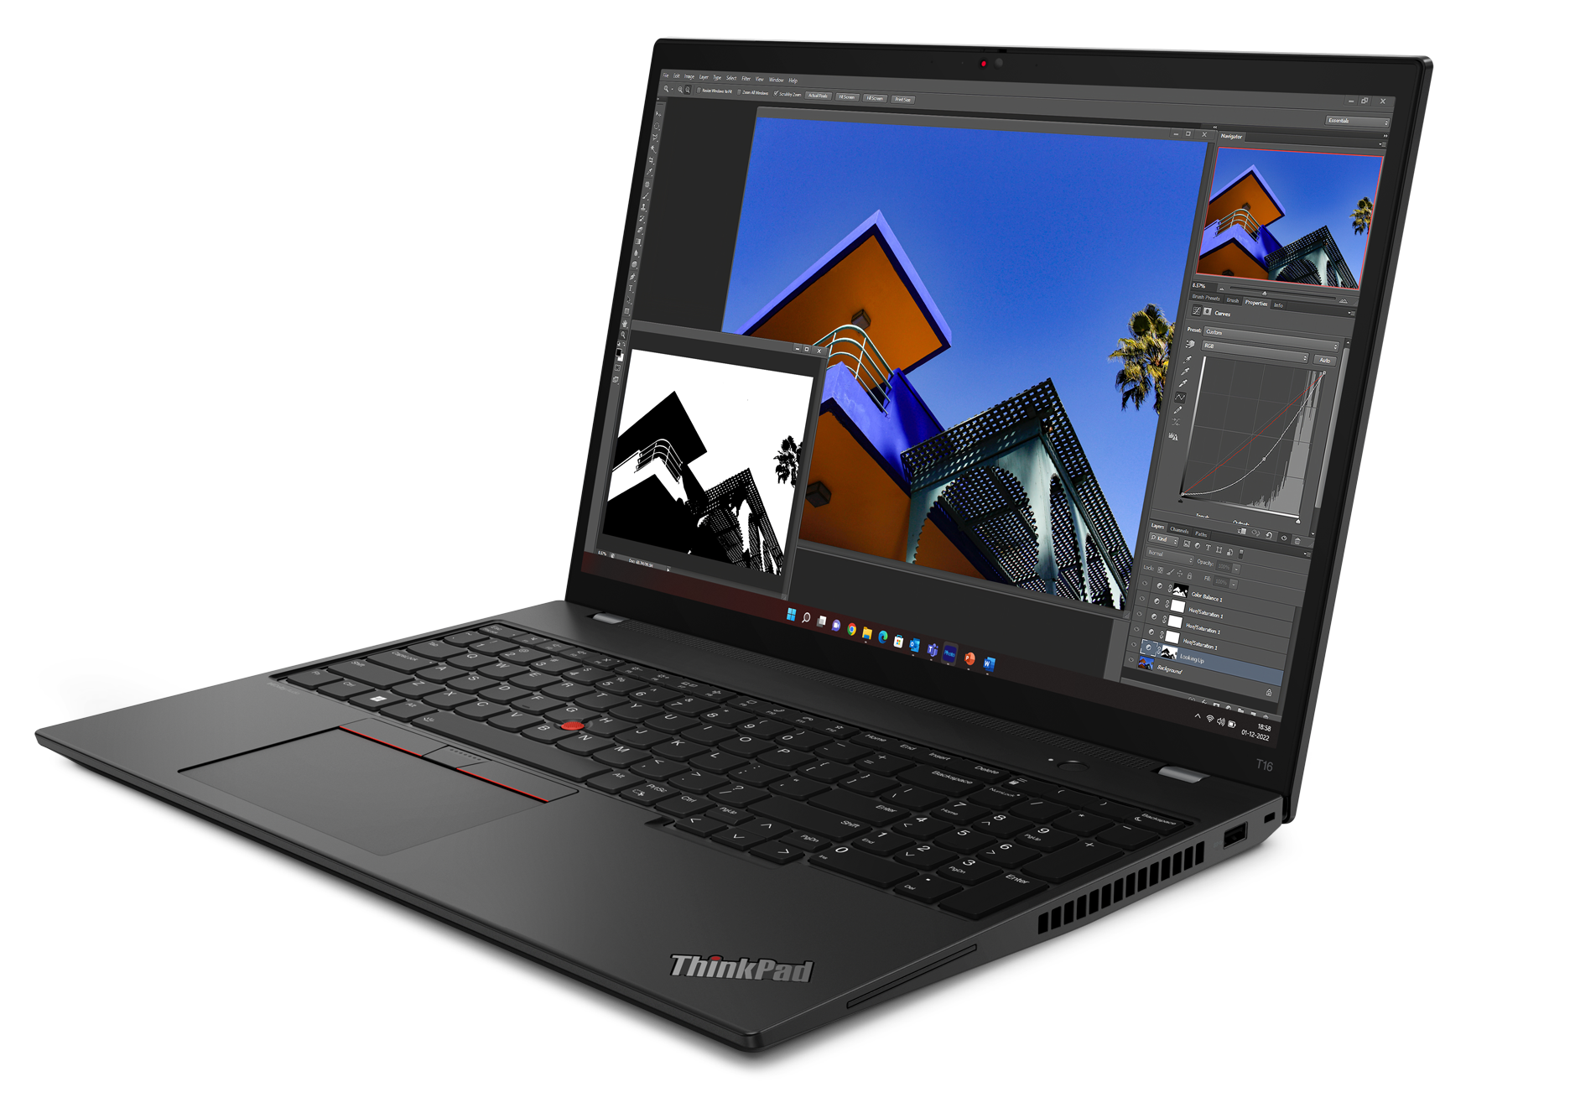
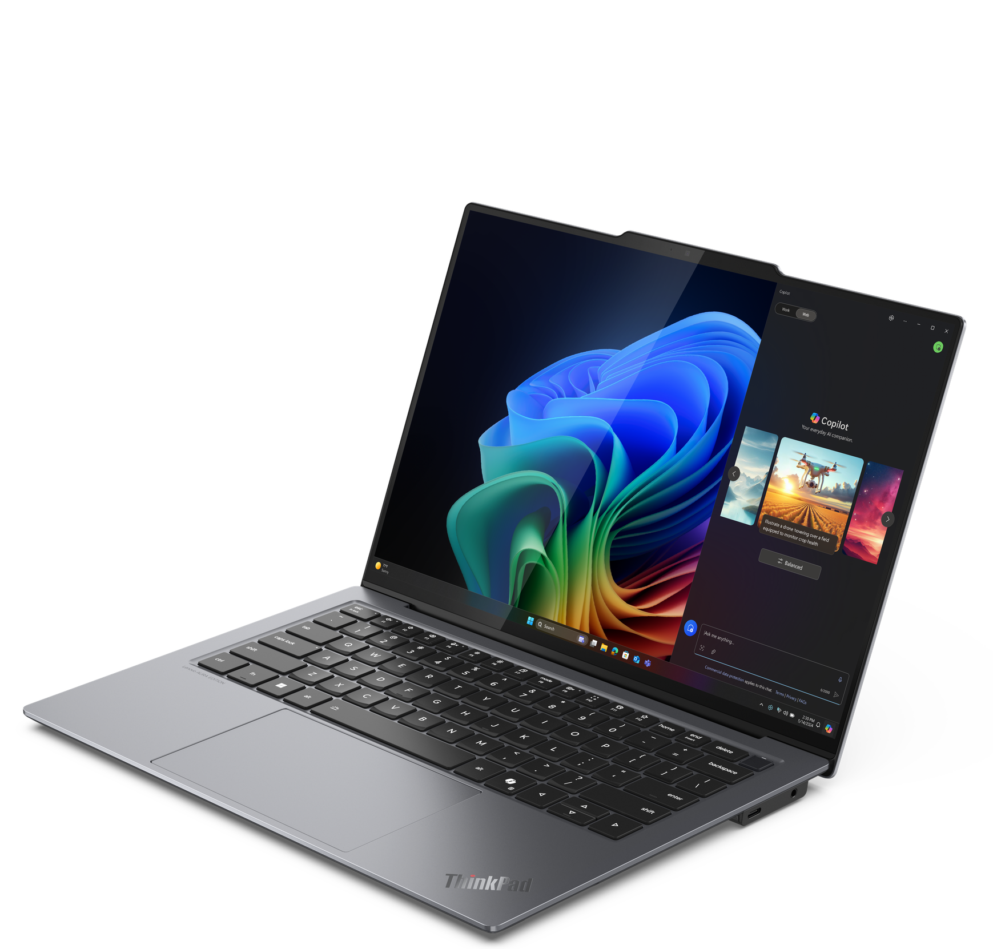
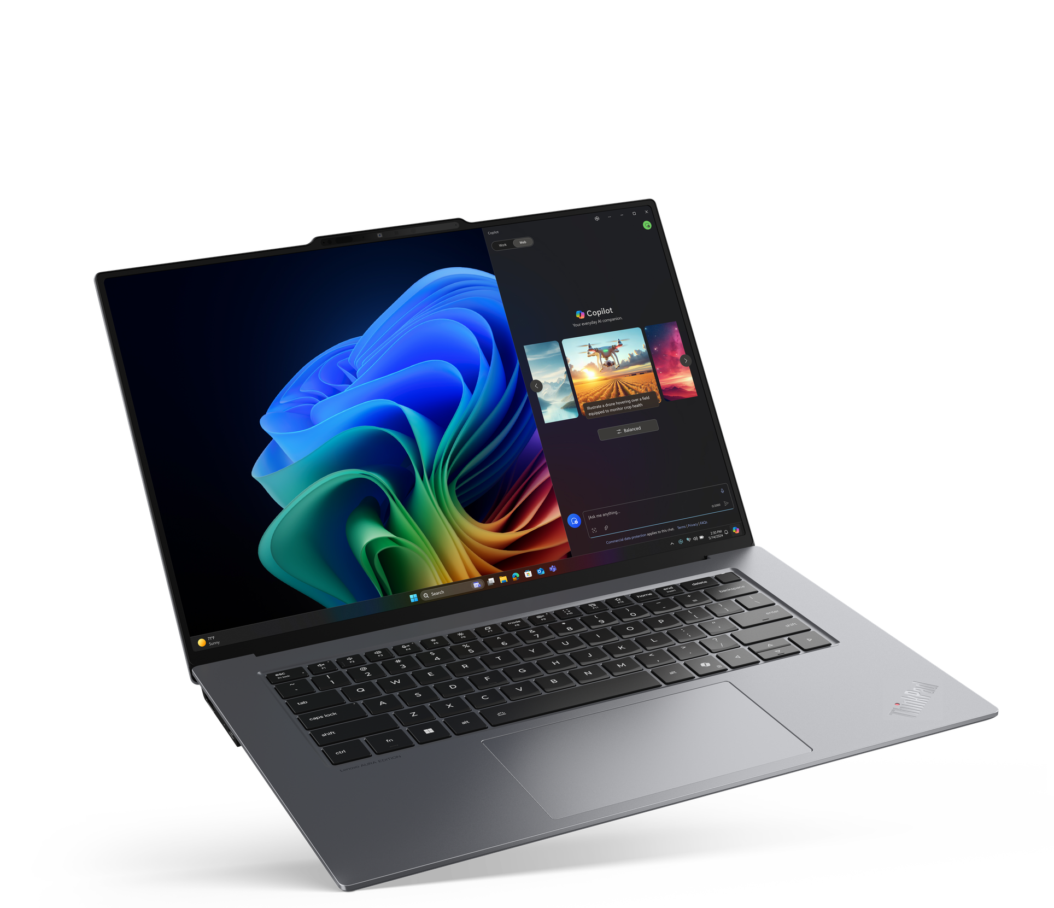
Premium ThinkPad
X1 Carbon 12th Gen
X1 2-in-1 9th Gen
T14s G5 (Intel/AMD)
T14 G5 (Intel/AMD)
T16 G2 (Intel/AMD)
T14s G6 (Qualcomm)
X9-14
X9-15

Slide 4

Premium ThinkPad T Series
T14 G5 (Intel) | $2,189 | $2,389 | $2,419 | $2,629 | $2,689 | $2,419
 | $150 rebate | $250 rebate | $250 rebate | $250 rebate | $150 rebate | $250 rebate
 | 21ML0052US/CA - Grey | 21ML0053US/CA - Grey | 21ML0089US/CA - Grey | 21ML0056US/CA | 21ML006MUS/CA - Grey | 21ML008NUS/CA
 | ULTRA 5 125U | ULTRA 5 125U | ULTRA 7 155U | ULTRA 5 135U Vpro | ULTRA 7 155U | ULTRA 7 165U Vpro
 | 16GB | 16GB | 16GB | 32GB | 32GB | 32GB
 | 256GB PCIe SSD | 512GB PCIe SSD | 512GB PCIe SSD | 512GB PCIe SSD | 512GB PCIe SSD | 512GB PCIe SSD
 | 14” WUXGA 400 NIT | 14" FHD Touch + IR Cam | 14” FHD 400 NIT | 14" FHD Touch + IR Cam | 14" FHD Touch + IR Cam | 14" FHD Touch + IR Cam
 | Camera, Backlit Keyboard, FPR, 2x2 + BT5.2, BT | Camera, Backlit Keyboard, FPR, 2x2 + BT5.2, BT | Camera, Backlit Keyboard, FPR, 2x2 + BT5.2, BT | Camera, Backlit Keyboard, FPR, 2x2 + BT5.2, BT | Camera, Backlit Keyboard, FPR, 2x2 + BT5.2, BT | Camera, Backlit Keyboard, FPR, 2x2 + BT5.2, BT
 | Integrated 52Wh | Integrated 52Wh | Integrated 52Wh | Integrated 52Wh | Integrated 52Wh | Integrated 52Wh
 | Windows 11 Pro | Windows 11 Pro | Windows 11 Pro | Windows 11 Pro | Windows 11 Pro | Windows 11 Pro
 | 1 Year Depot | 1 Year Depot | 1 Year Depot | 1 Year Depot | 1 Year Depot | 1 Year Depot
T14s G5 (Intel) | $2,579 | $2,739 | $3,219
 | $250 rebate | $200 rebate | $200 rebate
 | 21LS0058US/CA | 21LS0049US/CA | 21LS004FUS/CA - Grey
 | ULTRA 7 155U | ULTRA 5 135U Vpro | ULTRA 7 165U Vpro
 | 16GB | 32GB | 32GB
 | 512GB PCIe SSD | 512GB PCIe SSD | 1TB PCIe SSD
 | 14" FHD + IR Cam | 14" FHD Touch | 14" FHD Touch + IR Cam
 | Camera, Backlit Keyboard, FPR, 2x2 + BT5.2, BT | Camera, Backlit Keyboard, FPR, 2x2 + BT5.2, BT | Camera, Backlit Keyboard, FPR, 2x2 + BT5.2, BT
 | Integrated 58Wh | Integrated 58Wh | Integrated 58Wh
 | Windows 11 Pro | Windows 11 Pro | Windows 11 Pro
 | 1 Year Depot | 1 Year Depot | 1 Year Depot
T14s Qualcomm G6 | $1,999 | $2,449
 | $200 rebate | $200 rebate
 | 21N1002DUS/CA | 21N10000US/CA
 | QC X1P42100 8C | QC X1E78100 12C
 | 16GB | 32GB
 | 512GB PCIe SSD | 1TB PCIe SSD
 | 14" FHD + IR Cam | 14" FHD + IR Cam
 | Camera, Backlit Keyboard, FPR, 2x2 + BT5.2, BT | Camera, Backlit Keyboard, FPR, 2x2 + BT5.2, BT
 | Integrated 58Wh | Integrated 58Wh
 | Windows 11 Pro | Windows 11 Pro
 | 1 Year Depot | 1 Year Depot
T16 G3 (Intel) | $2,399 | $2,519 | $2,679 | $3,099
 | $375 rebate | $375 rebate | $325 rebate | $325 rebate
 | 21MN005MUS/CA | 21MN00AHUS/CA | 21MN0070US/CA | 21MN005HUS/CA
 | ULTRA 5 125U | ULTRA 7 155U | ULTRA 7 155U | ULTRA 7 165U Vpro
 | 16GB | 16GB | 32GB | 32GB
 | 512GB PCIe SSD | 512GB PCIe SSD | 512GB PCIe SSD | 1TB PCIe SSD
 | 14" FHD Touch + IR Cam | 14" FHD Touch | 14" FHD Touch | 14" FHD Touch + IR Cam
 | Camera, Backlit Keyboard, FPR, 2x2 + BT5.2, BT | Camera, Backlit Keyboard, FPR, 2x2 + BT5.2, BT | Camera, Backlit Keyboard, FPR, 2x2 + BT5.2, BT | Camera, Backlit Keyboard, FPR, 2x2 + BT5.2, BT
 | Integrated 86Wh | Integrated 86Wh | Integrated 86Wh | Integrated 86Wh
 | Windows 11 Pro | Windows 11 Pro | Windows 11 Pro | Windows 11 Pro
 | 1 Year Depot | 1 Year Depot | 1 Year Depot | 1 Year Depot
T14 AMD G5 | $1,029 | $1,121 | $1,278
 | 21MC000NUS - Grey | 21MC000CUS | 21MC004YUS
 | Ryzen 5 PRO 8540U | Ryzen 7 PRO 8840U | Ryzen 7 PRO 8840U
 | 16GB | 16GB | 32GB
 | 256GB PCIe SSD | 512GB PCIe SSD | 512GB PCIe SSD
 | 14" FHD + IR Cam | 14" FHD + IR Cam | 14" FHD + Touch + IR Cam
 | Camera, Backlit Keyboard, FPR, Wi-Fi 6E, 11ax, 2x2 + BT5.2 | IR Camera, Backlit Keyboard, FPR, Wi-Fi 6E, 11ax, 2x2 + BT5.2 | 5MP IR Camera, BL Keyboard, FPR, Wi-Fi 6E, 11ax, 2x2 + BT5.2
 | Integrated 52Wh | Integrated 52Wh | Integrated 52Wh
 | Windows 11 Pro | Windows 11 Pro | Windows 11 Pro
 | 1 Year Depot | 1 Year Depot | 1 Year Depot
T16 AMD G2 | $965 | $1,232
 | 21K7005FUS | 21K70008US
 | Ryzen 5 PRO 7545U | Ryzen 7 PRO 7840U
 | 16GB | 16GB
 | 256GB PCIe SSD | 512GB PCIe SSD
 | 14" HD + Cam | 14" FHD + Touch + IR Cam
 | Camera, Backlit Keyboard, FPR, Wi-Fi 6E, 11ax, 2x2 + BT5.2 | 5MP IR Camera, BL Keyboard, FPR, Wi-Fi 6E, 11ax, 2x2 + BT5.2
 | Integrated 52Wh | Integrated 52Wh
 | Windows 11 Pro | Windows 11 Pro
 | 1 Year Depot | 3 Year Depot

Slide 5
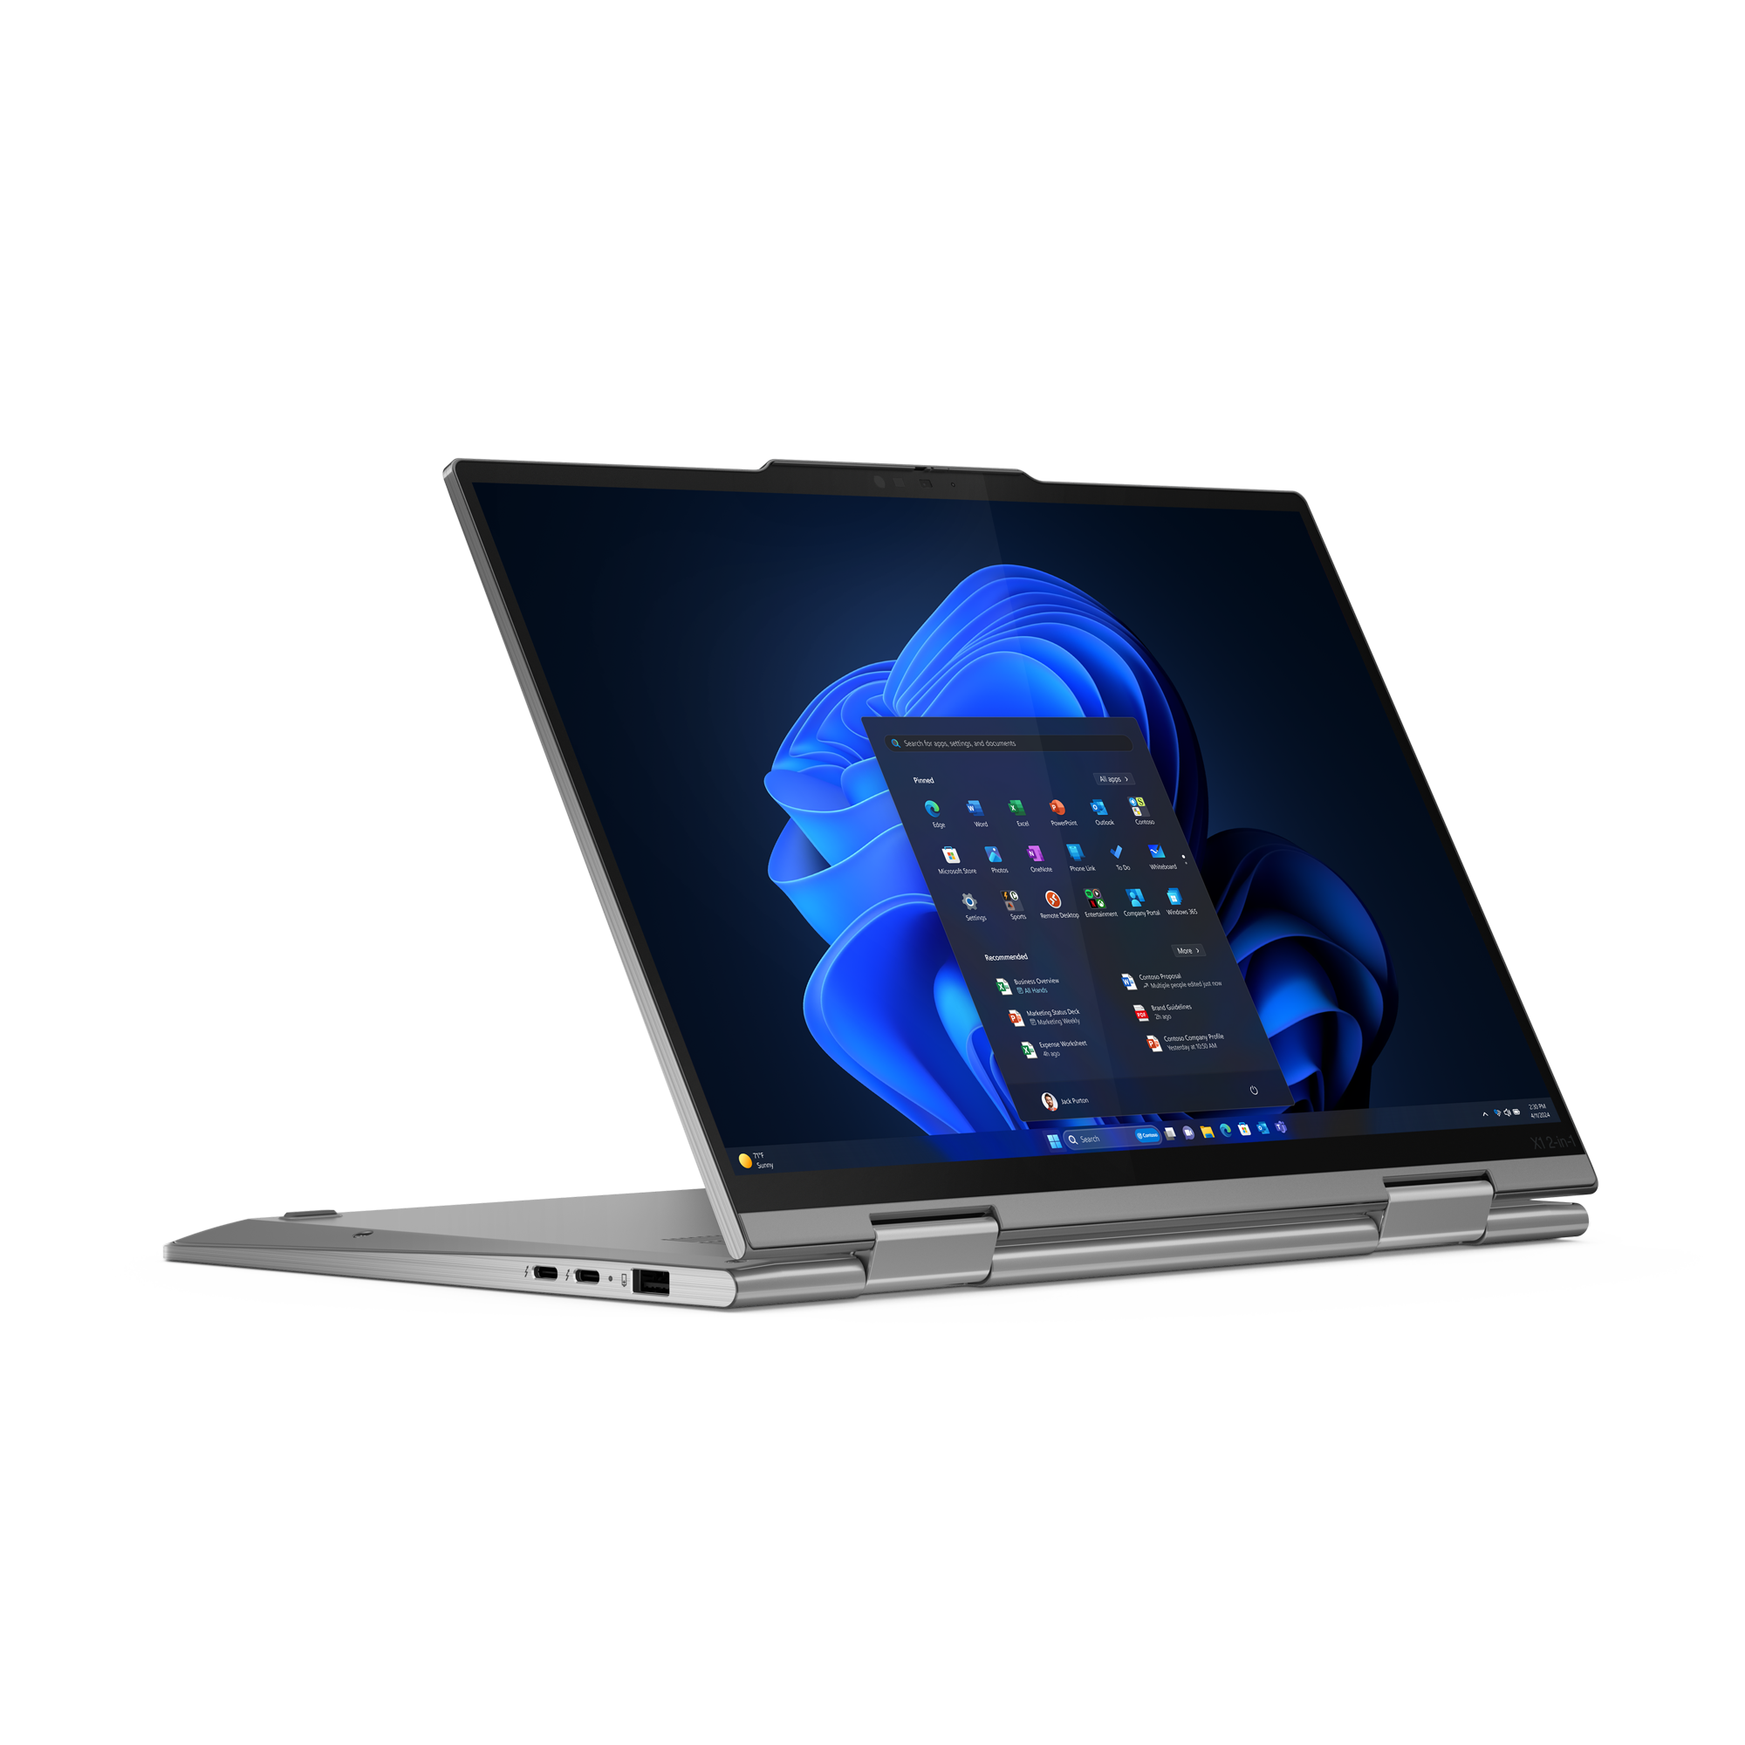

Premium ThinkPad X Series
X1 Carbon 12th Gen | $2,709 | $2,949 | $3,199 | $3,309
 | $200 rebate | $225 rebate | $225 rebate
 | 21KC00A0US/CA | 21KC00A8US/CA | 21KC00A7US/CA | 21KC00B1US/CA
 | ULTRA 5 125U | ULTRA 7 155U | ULTRA 7 155U | ULTRA 7 165U Vpro
 | 16GB | 16GB | 32GB | 32GB
 | 512GB PCIe SSD | 512GB PCIe SSD | 512GB PCIe SSD | 512GB PCIe SSD
 | 14" FHD + IR Cam | 14" FHD + IR Cam | 14" FHD Touch + IR Cam | 14" FHD Touch + IR Cam
 | Camera, Backlit Keyboard, FPR, 2x2 + BT5.2, BT | Camera, Backlit Keyboard, FPR, 2x2 + BT5.2, BT | Camera, Backlit Keyboard, FPR, 2x2 + BT5.2, BT | Camera, Backlit Keyboard, FPR, 2x2 + BT5.2, BT
 | Integrated 57Wh | Integrated 57Wh | Integrated 57Wh | Integrated 57Wh
 | Windows 11 Pro | Windows 11 Pro | Windows 11 Pro | Windows 11 Pro
 | 3 Year Premier Support | 3 Year Premier Support | 3 Year Premier Support | 3 Year Premier Support
X1 Carbon 13th Gen | $2,879
 | 21NS0014US
 | ULTRA 7 258V
 | 32GB
 | 512GB PCIe SSD
 | 14" OLED + IR Cam
 | Camera, Backlit Keyboard, FPR, 2x2 + BT5.2, BT
 | Integrated 57Wh
 | Windows 11 Pro
 | 1 Year Depot
X1 2-in-1 G9 | $1,949 | $2,106
 | $175 rebate | $200 rebate
 | 21KE005PUS/CA - Grey | 21KE005UUS/CA – Grey
 | ULTRA 5 125U | ULTRA 7 155U
 | 16GB | 16GB
 | 512GB PCIe SSD | 512GB PCIe SSD
 | 14" FHD Touch + IR Cam | 14" FHD + Touch + IR Cam
 | Camera, Backlit KBD, FPR, 2x2 AX WLAN, BT, Pen | Camera, Backlit KBD, FPR, 2x2 AX WLAN, BT, Pen
 | Integrated 57Wh | Integrated 57Wh
 | Windows 11 Pro | Windows 11 Pro
 | 3 Year Premier Support | 3 Year Premier Support
NEW
NEW
X9-14 Gen 1 | $ 2,019 | $2,649 | $2,879
 | $100 rebate | $100 rebate | $100 rebate
 | 21QA0000US/CA | 21QA0004US/CA | 21QA0006US/CA
 | ULTRA 5 226V | ULTRA 7 268V | ULTRA 7 268V vPro
 | 16GB | 32GB | 32GB
 | 512GB SSD M.2 | 1TB SSD M.2 | 1TB SSD M.2
 | 14" WUXGA +IR Cam | 14" WUXGA +IR Cam | 14" WUXGA +IR Cam
 | Camera, Backlit KBD, FPR, 2x2 AX WLAN, BT | Camera, Backlit KBD, FPR, 2x2 AX WLAN, BT | Camera, Backlit KBD, FPR, 2x2 AX WLAN, BT
 | Integrated 55Wh | Integrated 55Wh | Integrated 55Wh
 | Windows 11 Pro | Windows 11 Pro | Windows 11 Pro
 | 1 Year Depot | 1 Year Depot | 1 Year Depot
X9-15 Gen 1 | $2,229 | $2,939 | $3,099
 | $100 rebate | $100 rebate | $100 rebate
 | 21Q60026US/CA | 21Q60027US/CA | 21Q60025US/CA
 | ULTRA 5 226V | ULTRA 7 268V | ULTRA 7 268V vPro
 | 16GB | 32GB | 32GB
 | 512GB SSD M.2 | 1TB SSD M.2 | 1TB SSD M.2
 | 15.3" 2.8K OLED +IR Cam | 15.3" 2.8K OLED +IR Cam | 15.3" 2.8K OLED +IR Cam
 | Camera, Backlit KBD, FPR, 2x2 AX WLAN, BT | Camera, Backlit KBD, FPR, 2x2 AX WLAN, BT | Camera, Backlit KBD, FPR, 2x2 AX WLAN, BT
 | Integrated 80Wh | Integrated 80Wh | Integrated 80Wh
 | Windows 11 Pro | Windows 11 Pro | Windows 11 Pro
 | 1 Year Depot | 1 Year Depot | 1 Year Depot

Slide 6
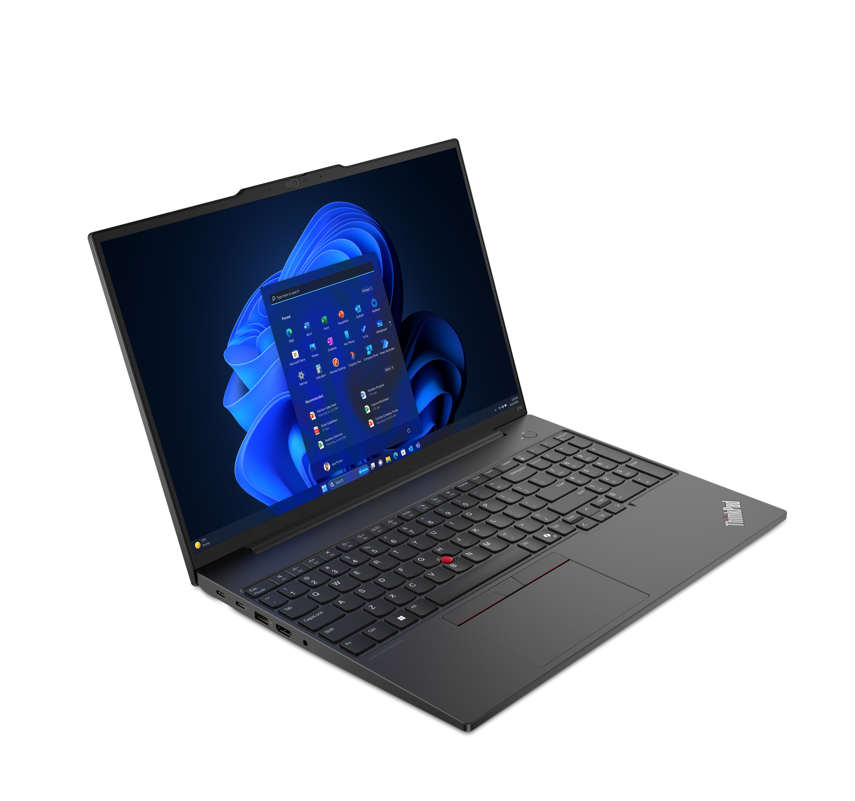
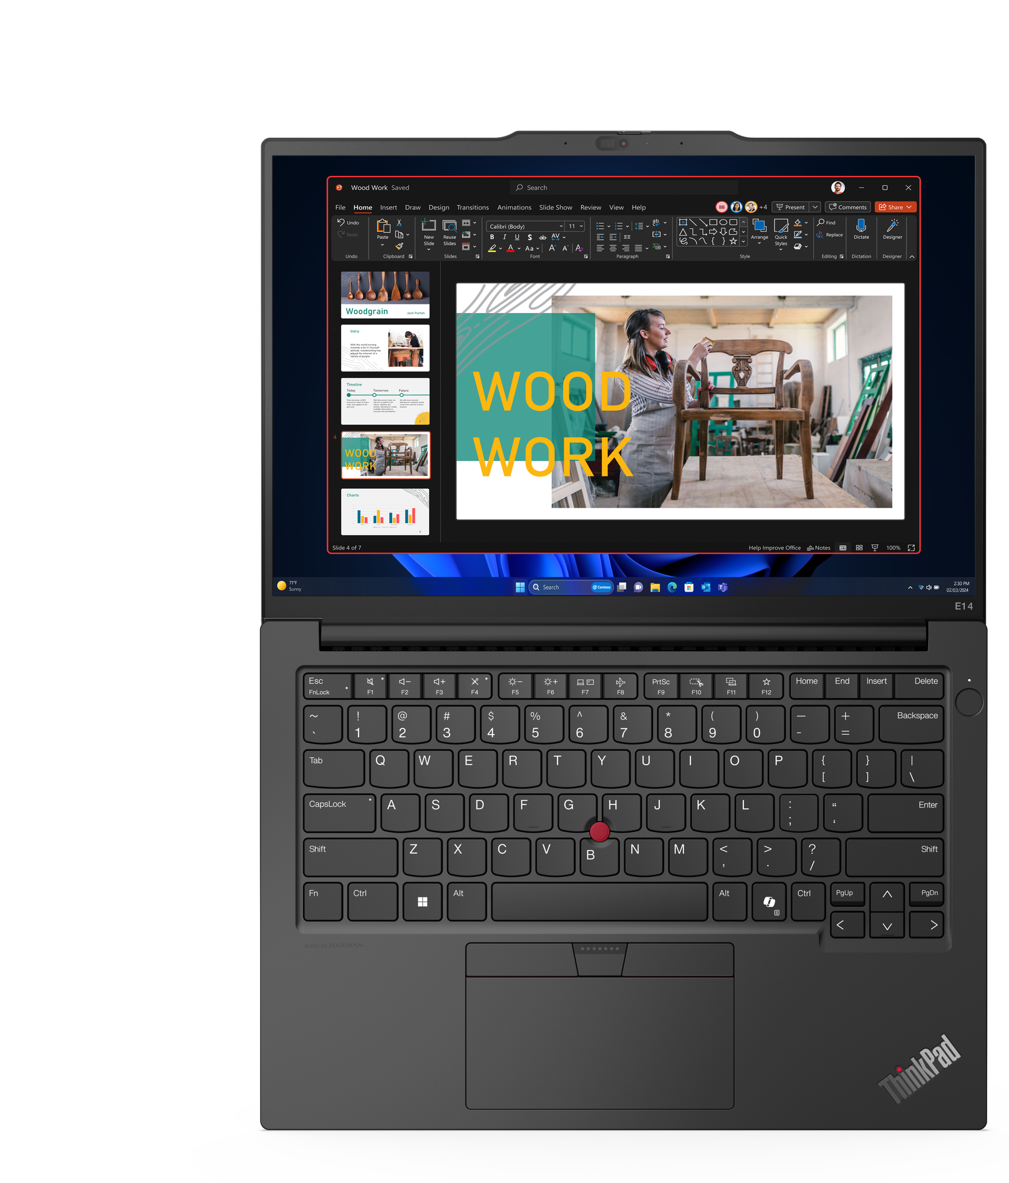
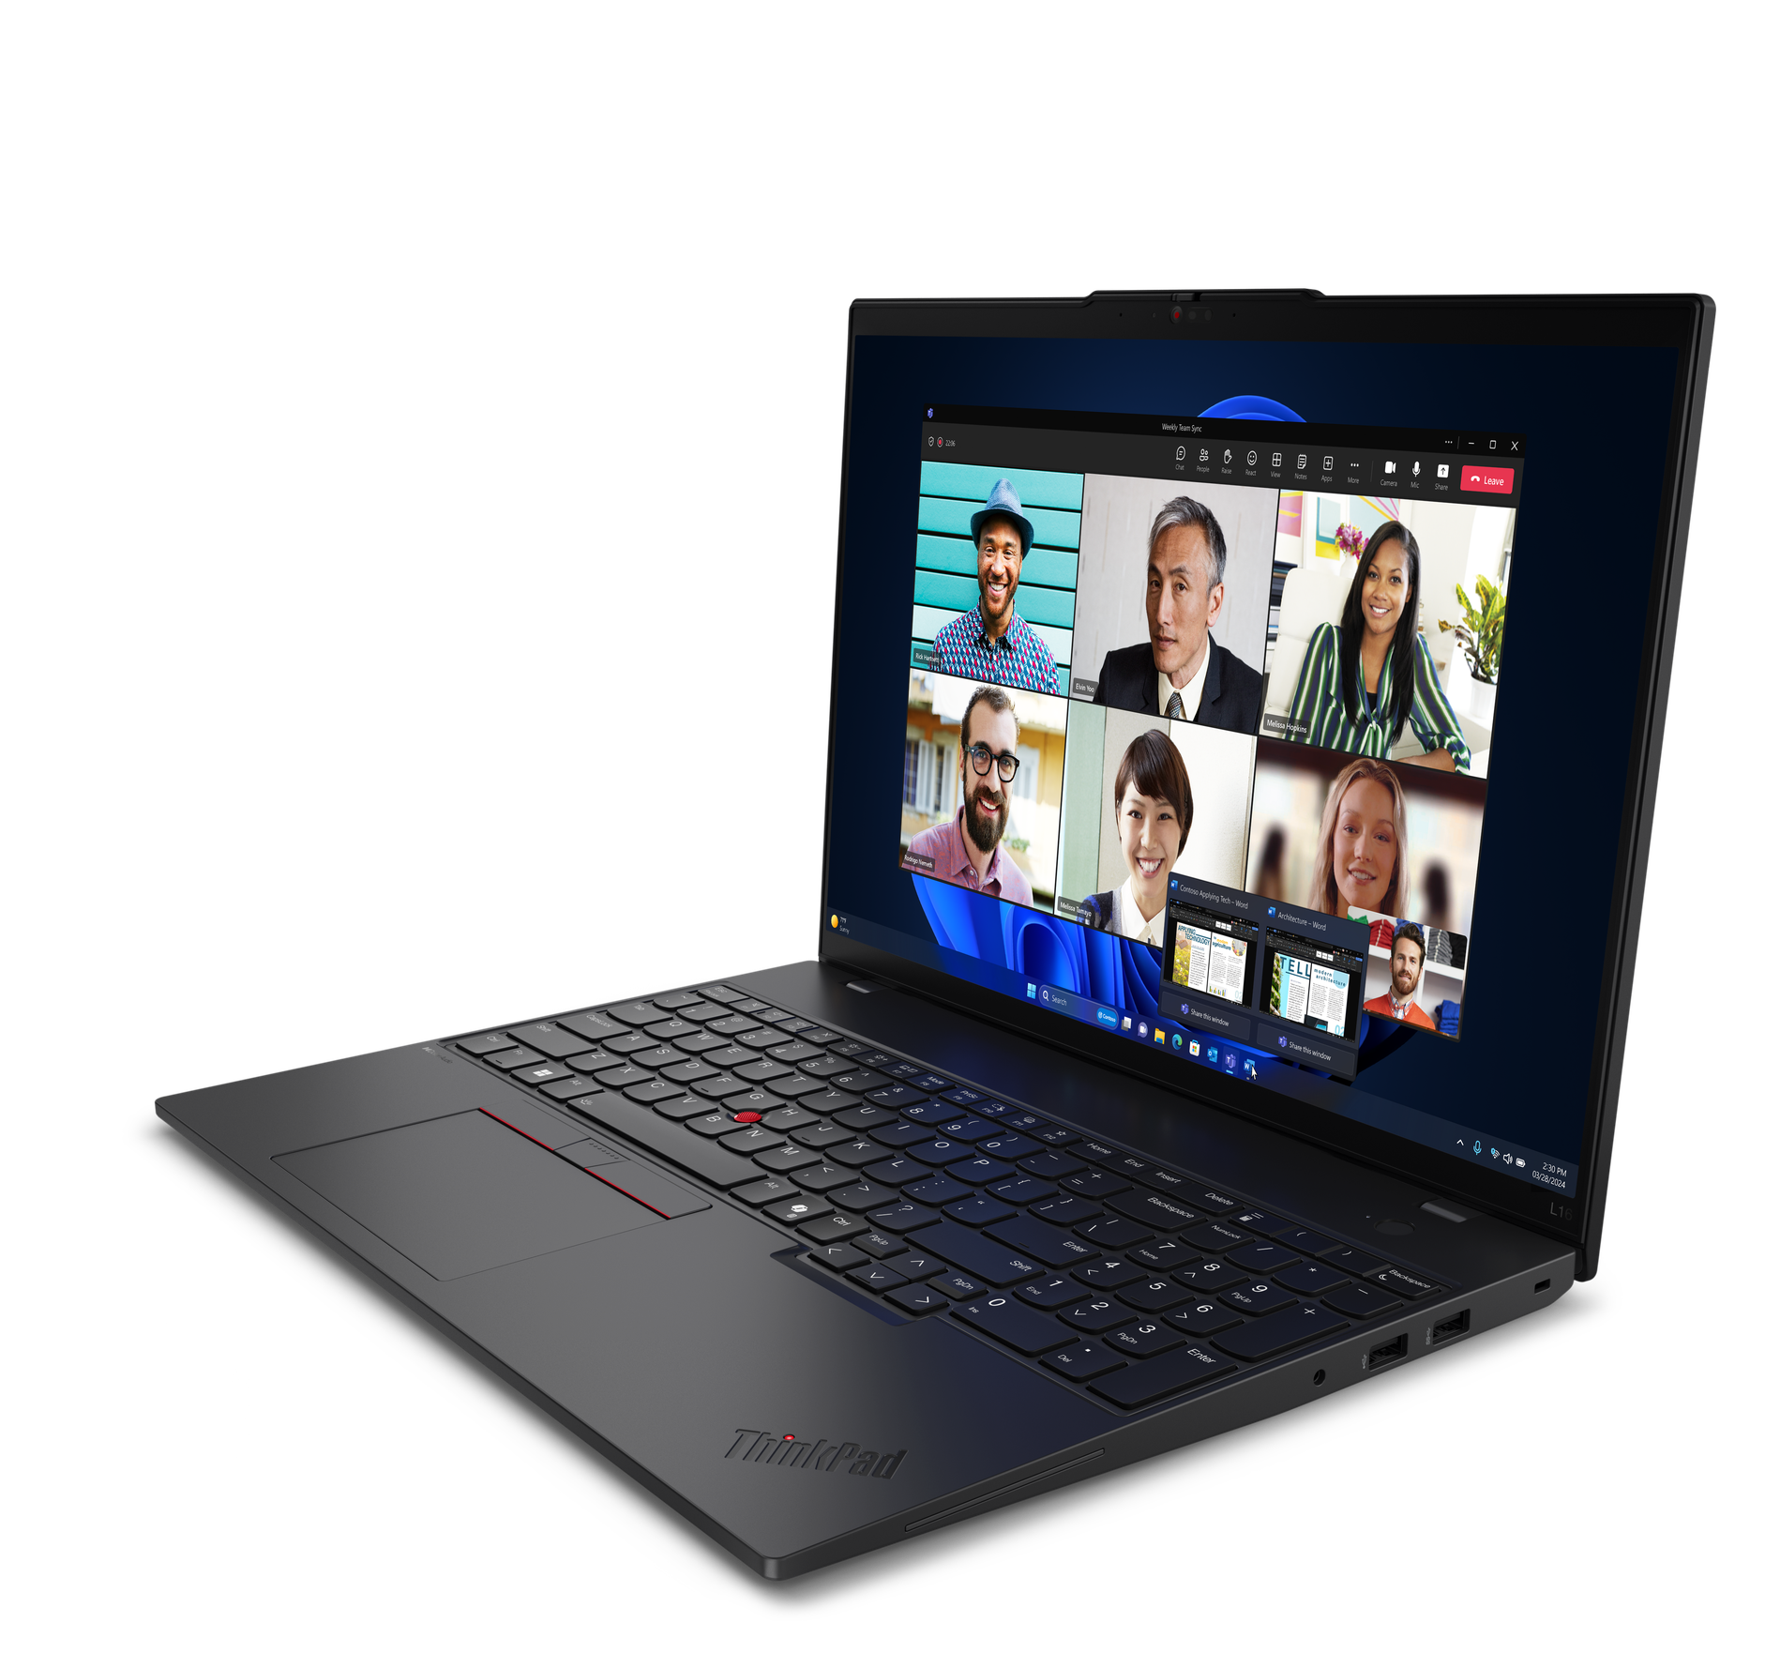
Velocity ThinkPad
E14 (Intel / AMD)
E16 (Intel/AMD)
L16 (Intel)

Slide 7
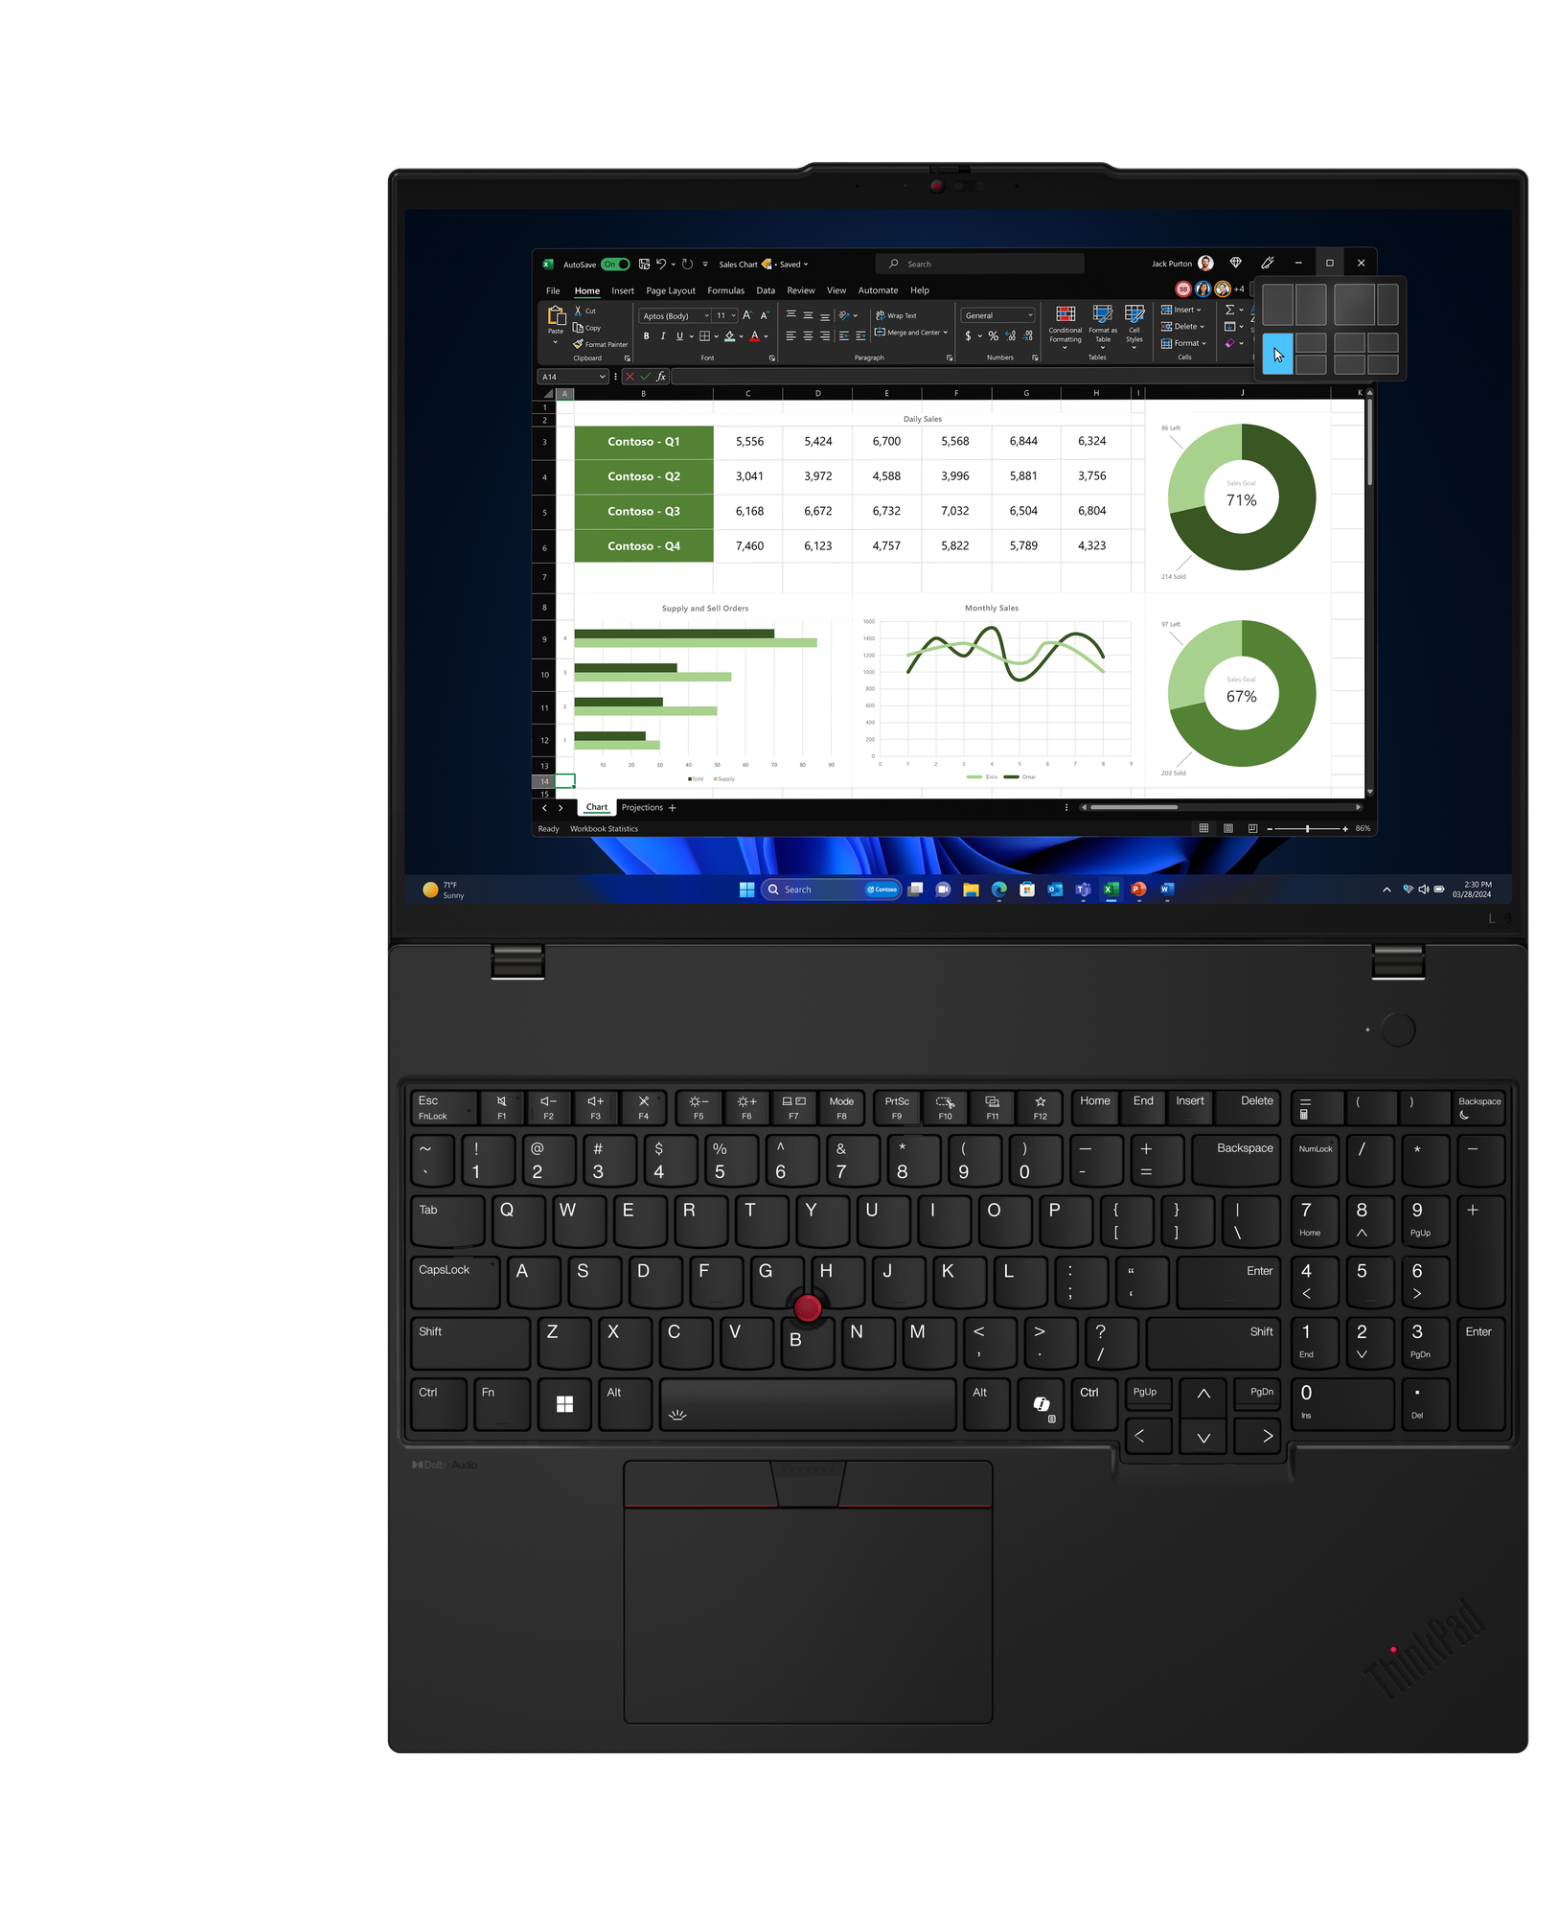
VELOCITY THINKPAD – E Series & L Series
E14 G6 | $1,339 | $1,609
 | $25 rebate | $25 rebate
 | 21M70006US/CA | 21M70007US/CA
 | Ultra 5 125U | Ultra 7 155U
 | 2 x 8GB DIMM | 2 x 8GB DIMM
 | 256GB SSD M.2 | 512GB SSD M.2
 | 14” WUXGA IPS Anti-glare | 14” WUXGA IPS Anti-glare
 | FHD Camera w/Shutter, 2x2 AX WLAN, BT | FHD Camera w/Shutter, 2x2 AX WLAN, BT
 | Integrated 47Whr Battery | Integrated 47Whr Battery
 | Win11 Pro | Win11 Pro
 | 1 Year Depot | 1 Year Depot
E16 G2 | $1,339 | $1,609
 | $25 rebate | $25 rebate
 | 21MA0003US/CA | 21MA0006US/CA
 | Ultra 5 125U | Ultra 7 155U
 | 2 x 8GB DIMM | 2 x 8GB DIMM
 | 256GB SSD M.2 | 512GB SSD M.2
 | 16” WUXGA IPS Anti-glare | 16” WUXGA IPS Anti-glare
 | FHD Camera w/Shutter, 2x2 AX WLAN, BT | FHD Camera w/Shutter, 2x2 AX WLAN, BT
 | Integrated 47Whr Battery | Integrated 47Whr Battery
 | Win11 Pro | Win11 Pro
 | 1 Year Depot | 1 Year Depot
E14 AMD G6 | $1,009 | $1,189
 | 21M3000RUS/CA | 21M3000NUS/CA
 | Ryzen 5 7535U | Ryzen 5 7735U
 | 1 x 8GB DIMM | 1 x 16GB DIMM
 | 256GB SSD NVMe | 256GB SSD NVMe
 | 14” WUXGA IPS Anti-glare | 14” WUXGA IPS Anti-glare
 | FHD Camera w/Shutter, 2x2 AX WLAN, BT | FHD Camera w/Shutter, 2x2 AX WLAN, BT
 | Integrated 47Whr Battery | Integrated 47Whr Battery
 | Win11 Pro | Win11 Pro
 | 1 Year Depot | 1 Year Depot
E16 AMD G2 | $1,009 | $1,189 | $1,349
 |  | $75 rebate | $75 rebate
 | 21M5000HUS/CA | 21M5000GUS/CA | 21M5000JUS/CA
 | Ryzen 5 7535U | Ryzen 5 7735U | Ryzen 7 7735U
 | 1 x 8GB DIMM | 1 x 16GB DIMM | 1 x 16GB DIMM
 | 256GB SSD NVMe | 256GB SSD NVMe | 512GB SSD NVMe
 | 16” WUXGA IPS Anti-glare | 16” WUXGA IPS Anti-glare | 16” WUXGA IPS Anti-glare
 | FHD Camera w/Shutter, 2x2 AX WLAN, BT | FHD Camera w/Shutter, 2x2 AX WLAN, BT | FHD Camera w/Shutter, 2x2 AX WLAN, BT
 | Integrated 47Whr Battery | Integrated 47Whr Battery | Integrated 47Whr Battery
 | Win11 Pro | Win11 Pro | Win11 Pro
 | 1 Year Depot | 1 Year Depot | 1 Year Depot
NEW
L16 G1 | $1,199 | $1,459
 | 21L3005EUS/CA | 21L3005FUS/CA
 | Ultra 5 125U | Ultra 7 155U
 | 1 x 16GB DIMM | 1 x 16GB DIMM
 | 512GB SSD M.2 | 512GB SSD M.2
 | 16” WUXGA IPS Anti-glare | 16” WUXGA IPS Anti-glare
 | HD Camera w/Shutter, 2x2 AX WLAN, BT | HD Camera w/Shutter, 2x2 AX WLAN, BT
 | Integrated 46.5Wh Battery | Integrated 46.5Wh Battery
 | Win11 Pro | Win11 Pro
 | 1 Year Depot | 1 Year Depot
L16 PC-ABS
E16 Aluminum

Slide 8
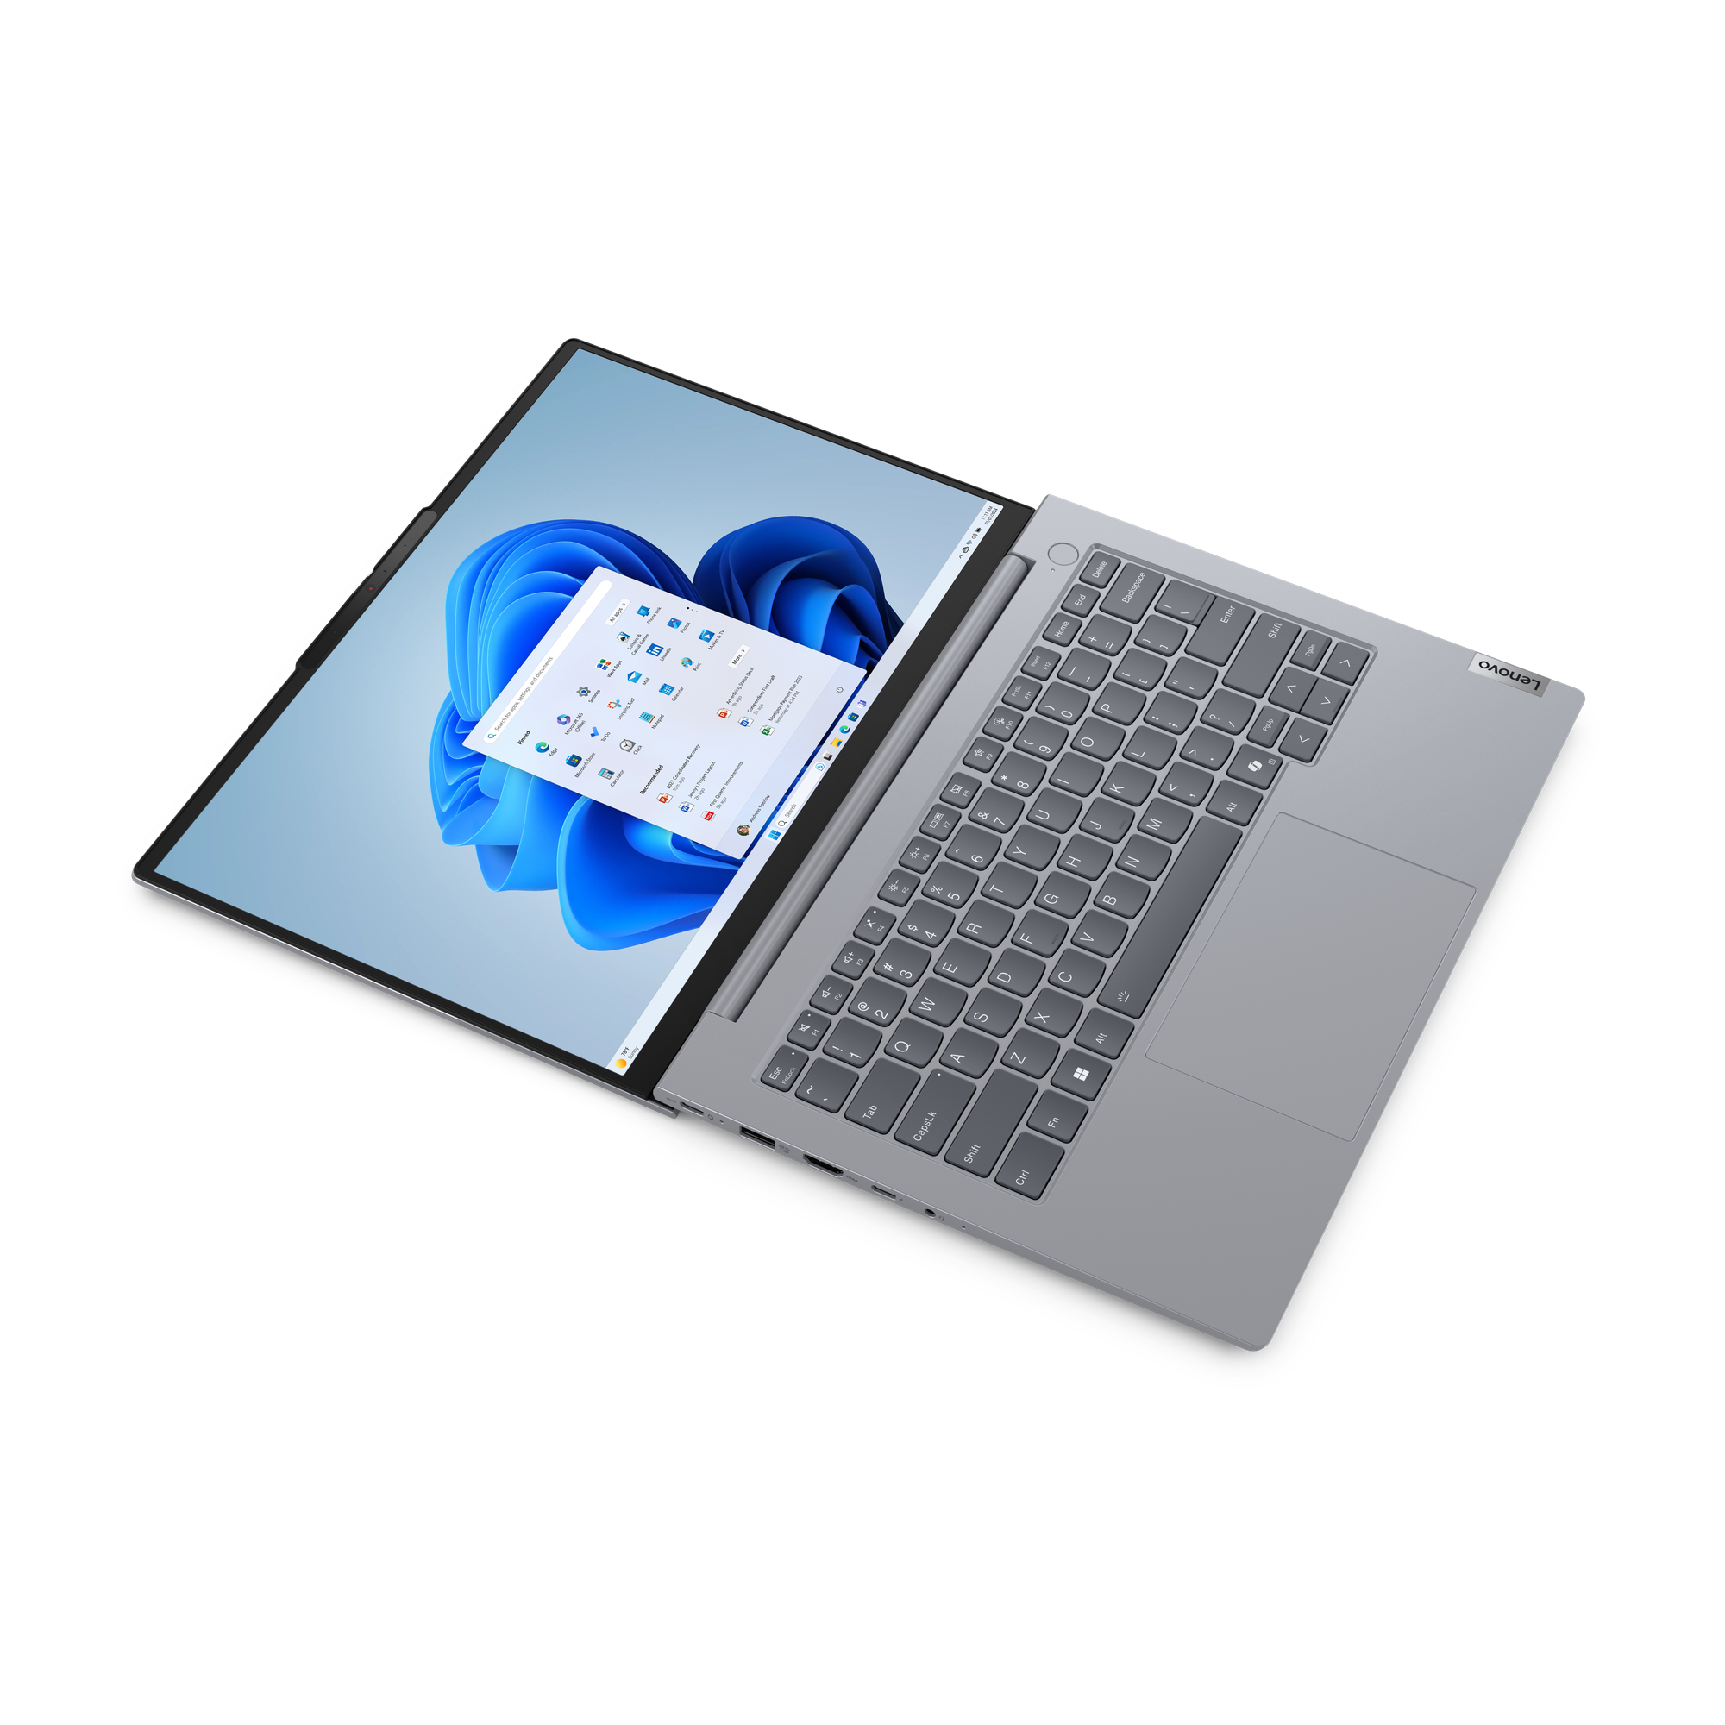
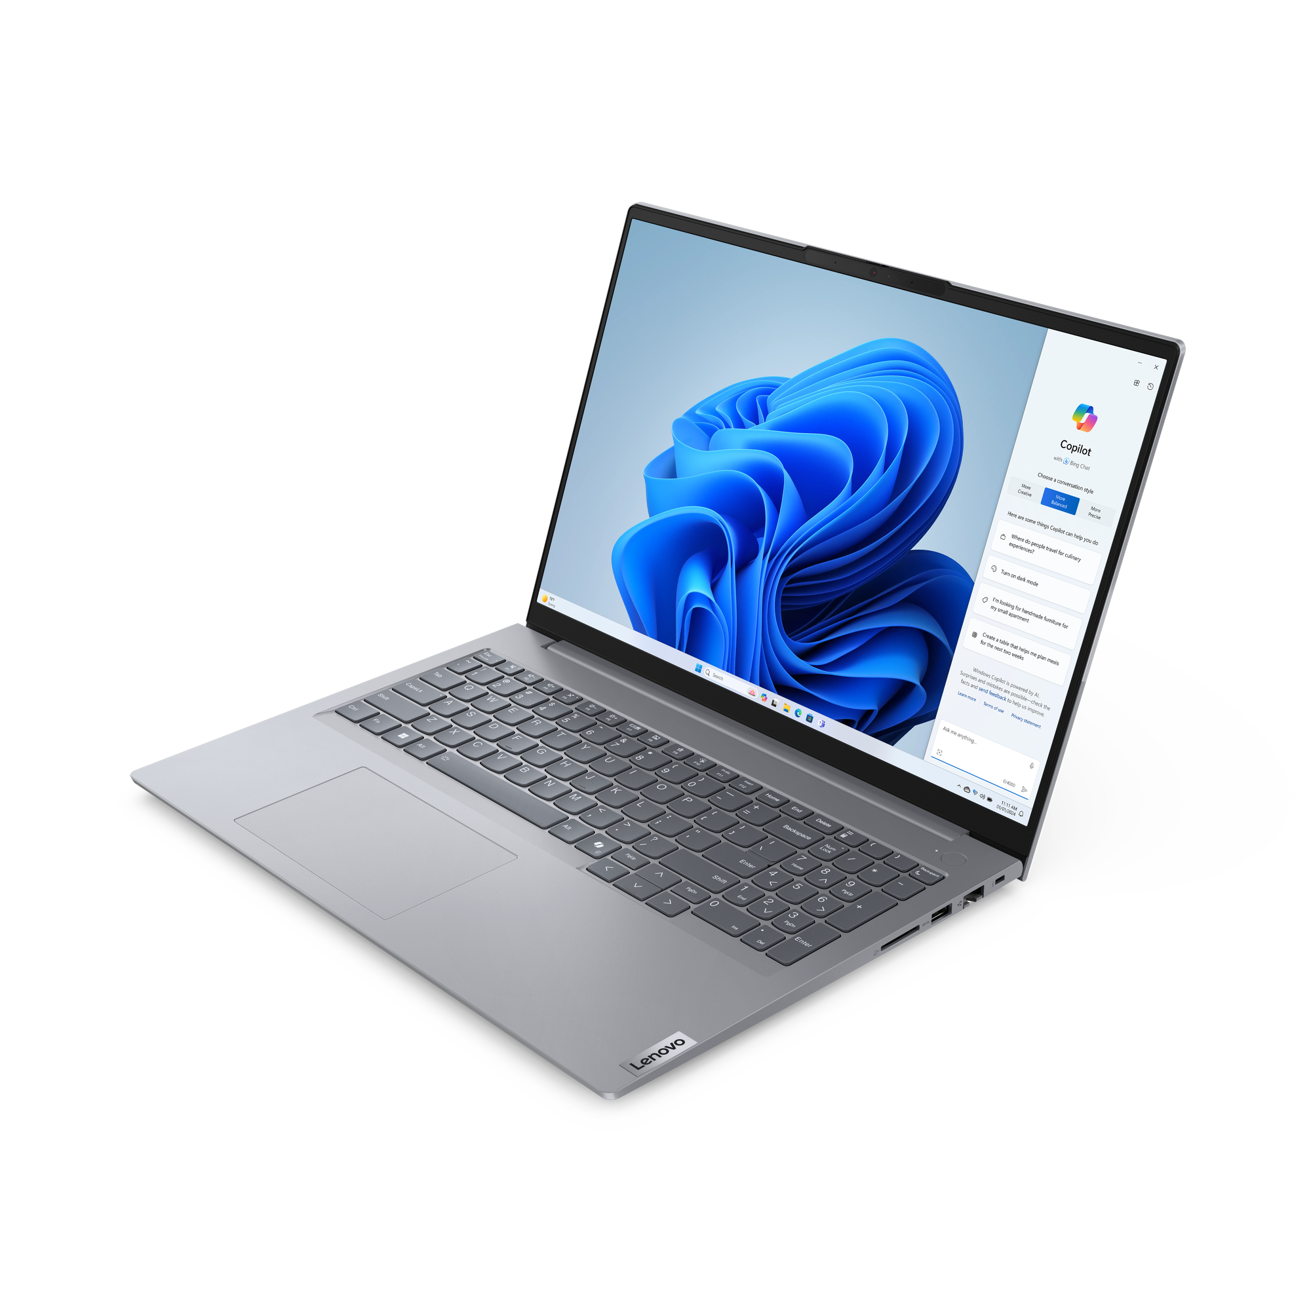
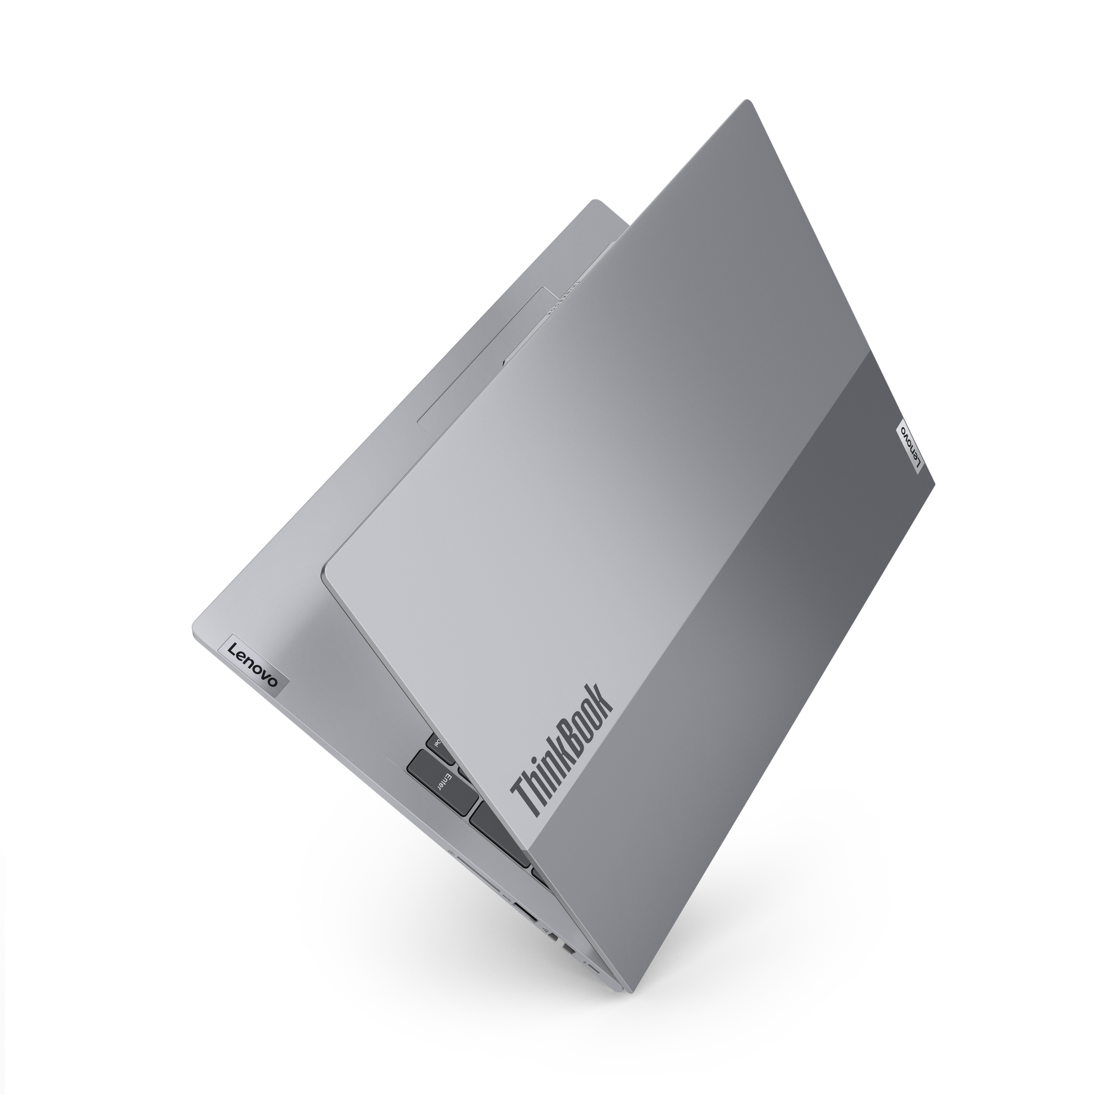
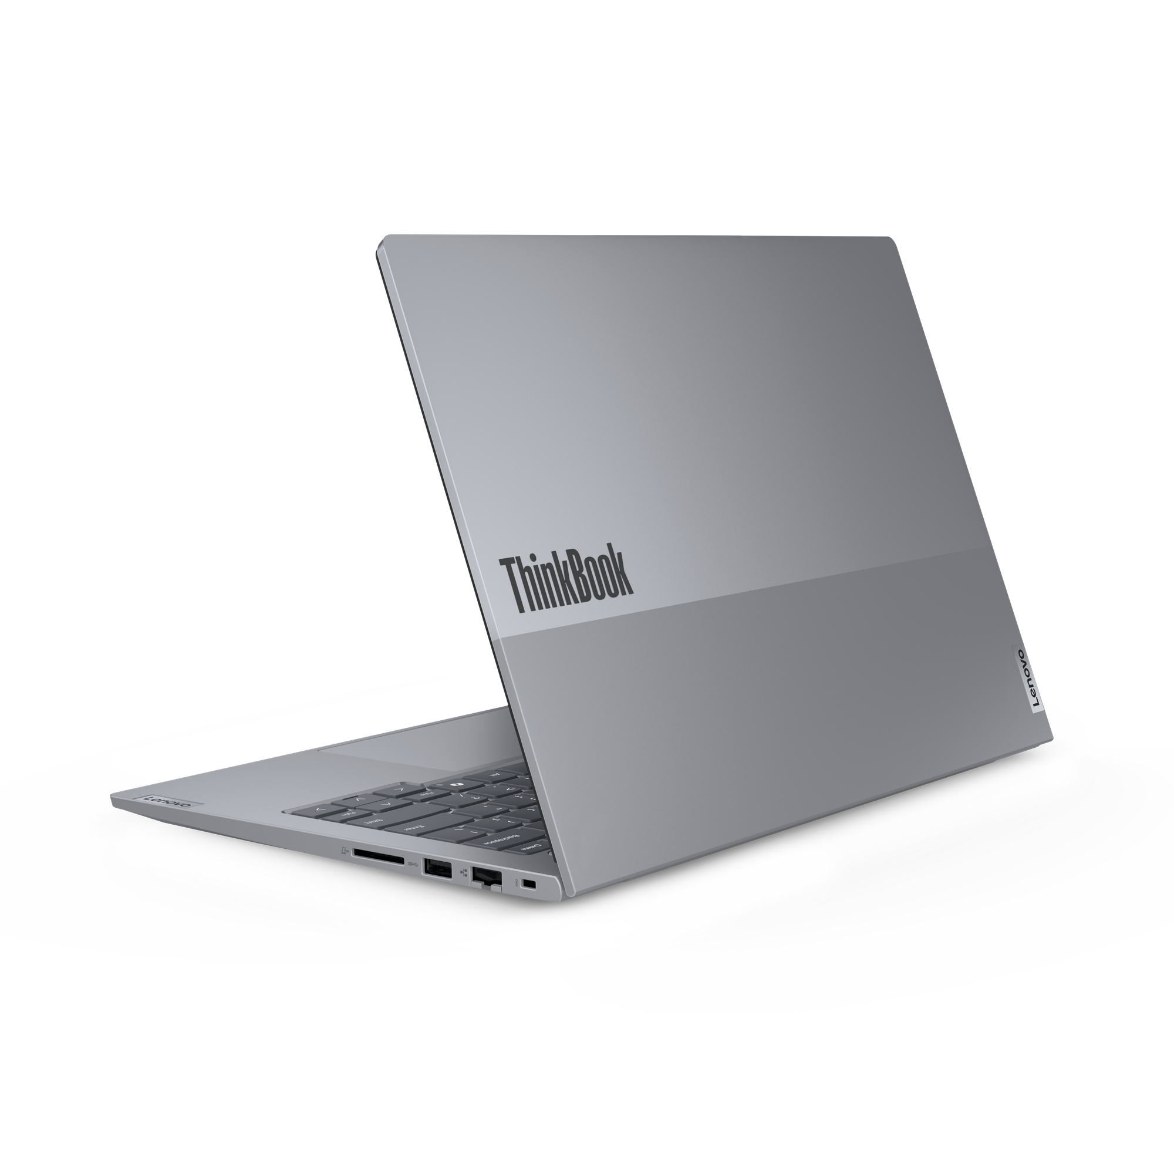
Lenovo Topseller Notebooks
ThinkBook 16 (Intel / AMD)
ThinkBook 14 (Intel / AMD)

Slide 9
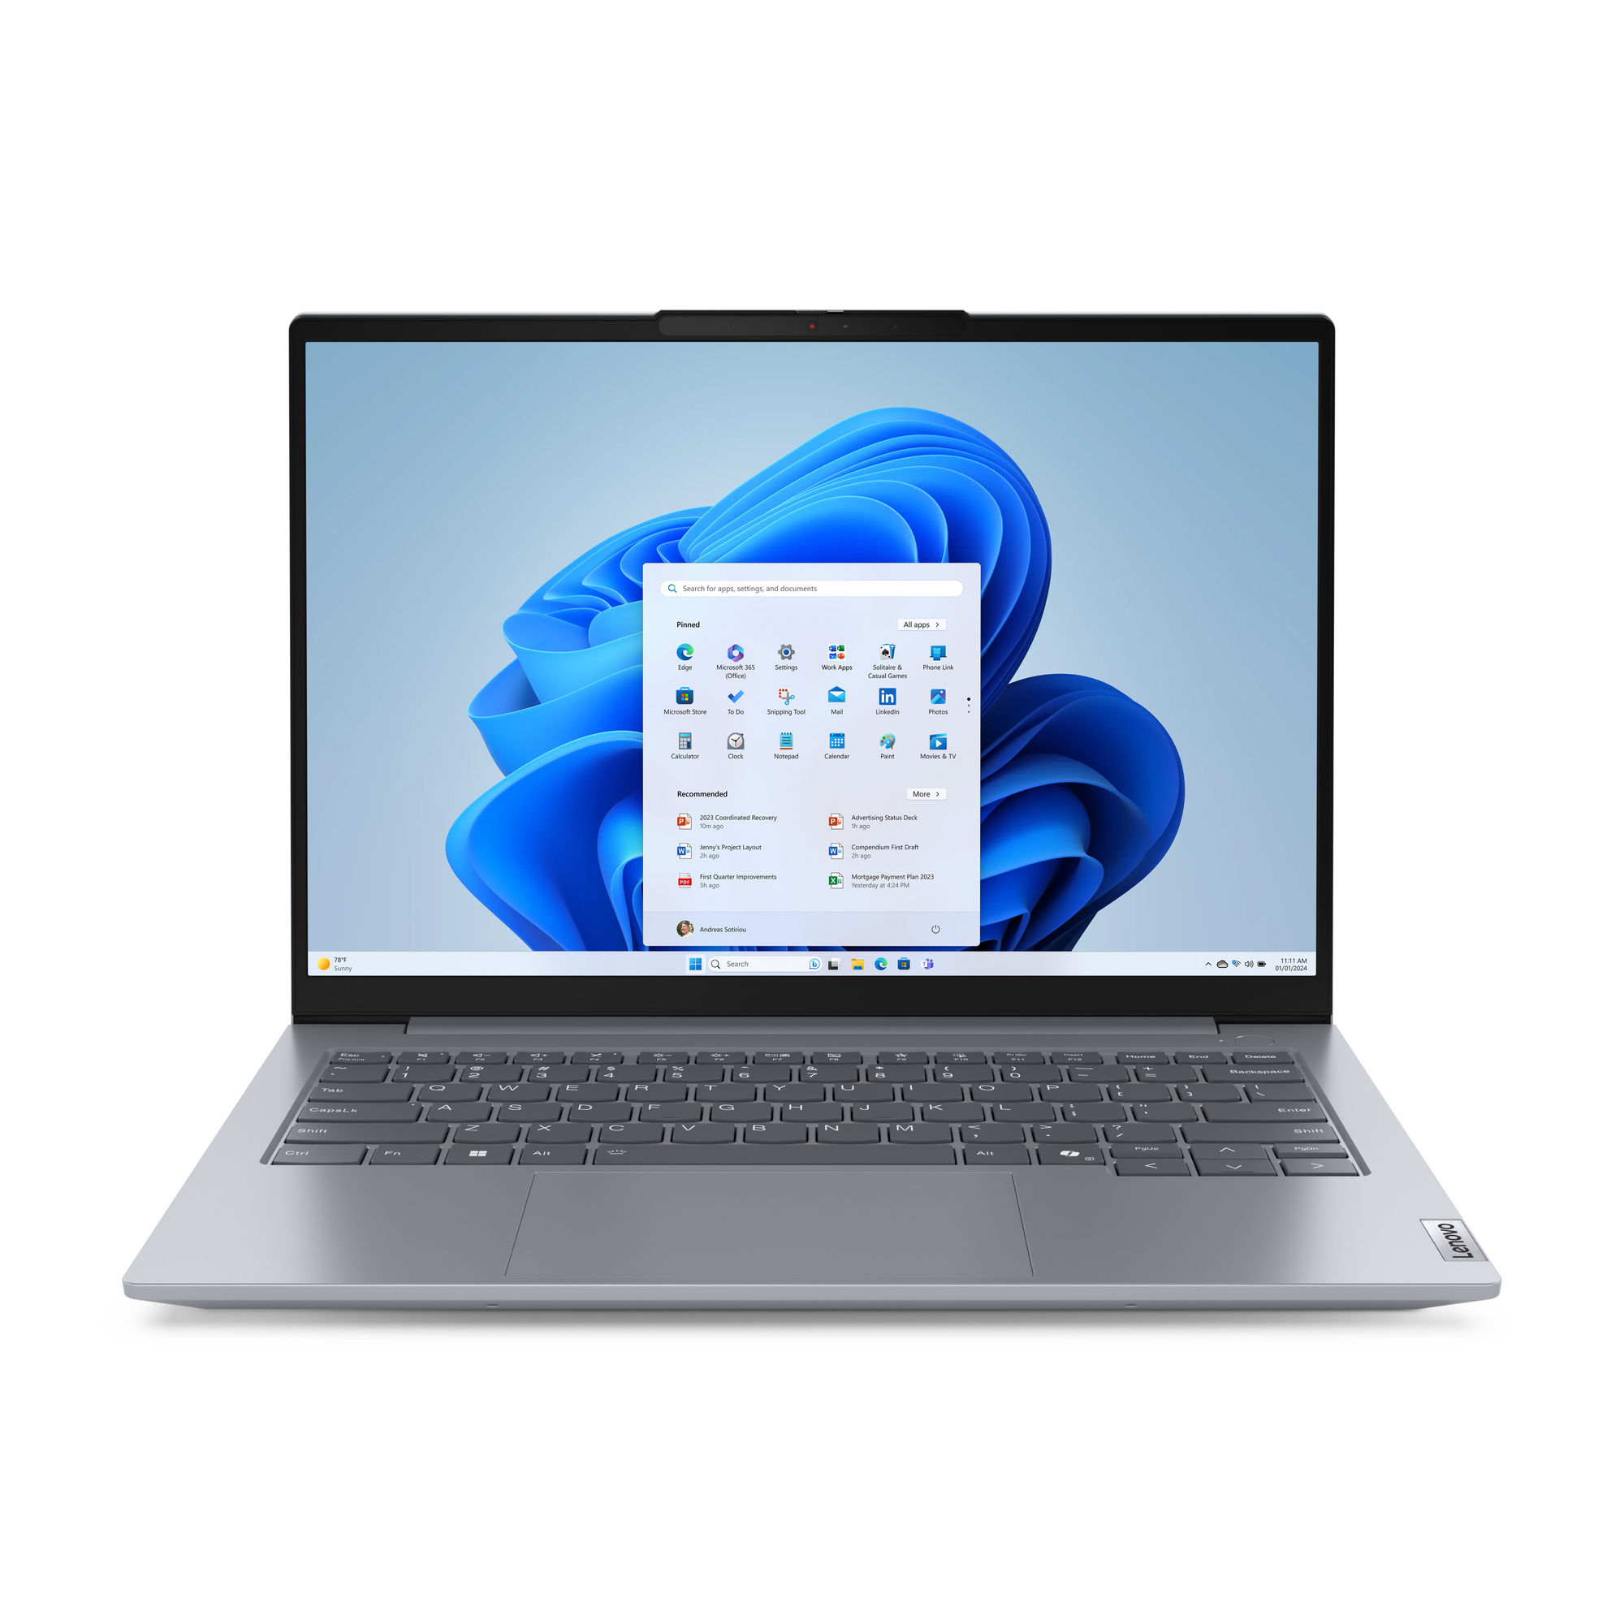
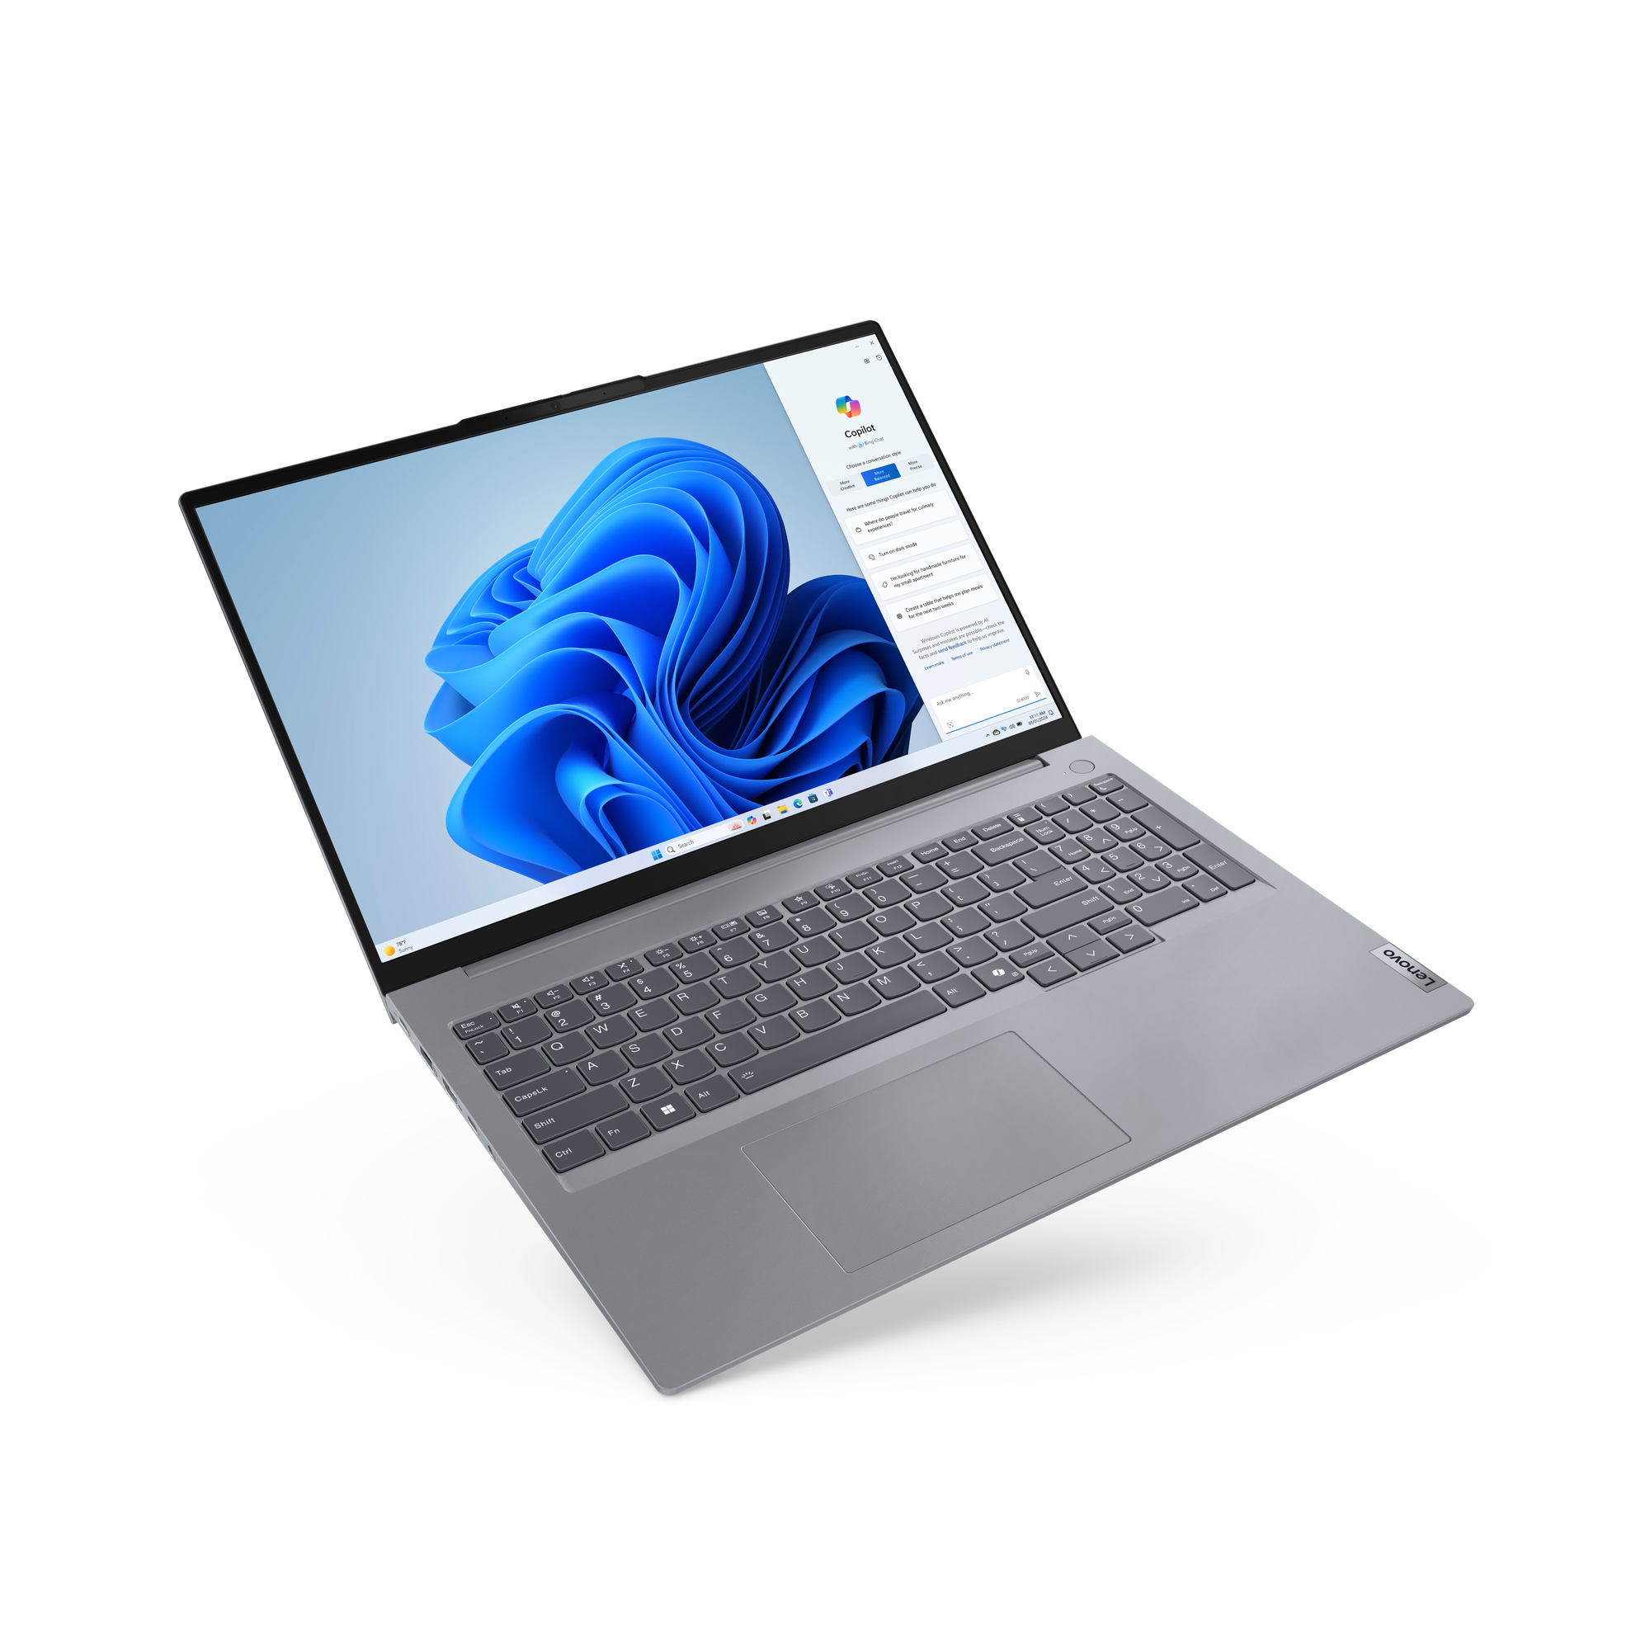
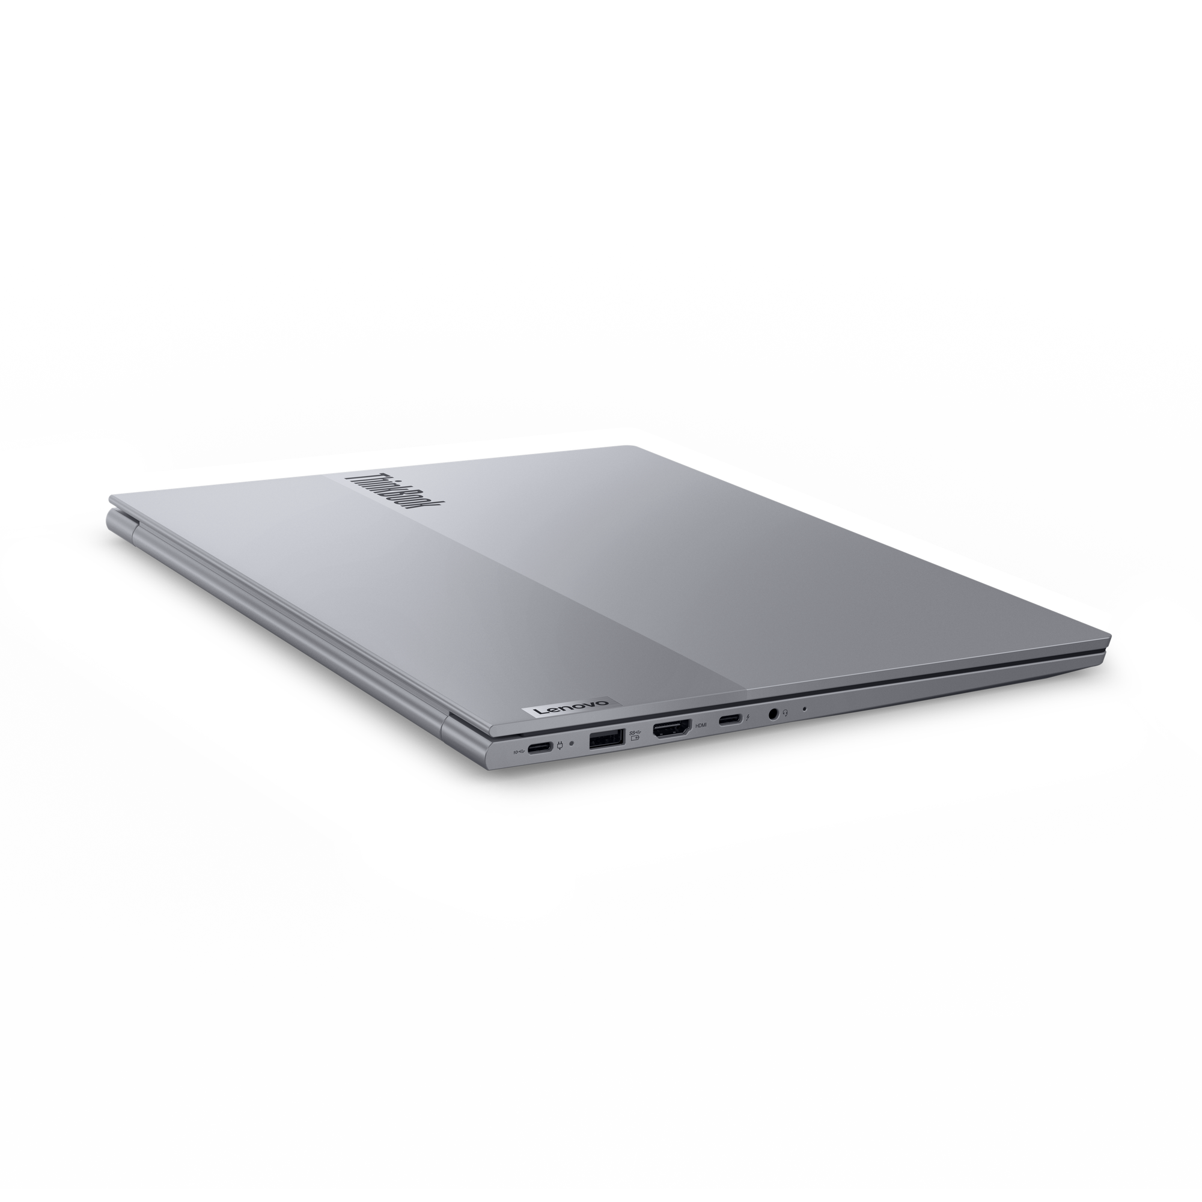
VELOCITY NOTEBOOKS – ThinkBook
ThinkBook 14 G7 (Intel) | $1,439 | $1,729
 | $150 rebate | $150 rebate
 | 21MR005QUS | 21MR005SUS
 | ULT5 125U | ULT7 155U
 | 1 x 16GB DIMM | 1 x 16GB DIMM
 | 256GB SSD NVMe | 512GB SSD NVMe
 | 14” WUXGA IPS Anti-glare | 14” WUXGA IPS Anti-glare Touch
 | FHD Camera w/Shutter, 2x2 AX WLAN, BT, Backlit Keyboard, Aluminum | FHD Camera w/Shutter, 2x2 AX WLAN, BT, Backlit Keyboard, Aluminum
 | Integrated 45Whr Battery | Integrated 45Whr Battery
 | Win11 Pro | Win11 Pro
 | 1 Year Depot | 1 Year Depot
ThinkBook 14 2-in-1 G4 | $1,729 | $2,009
 | $150 rebate | $150 rebate
 | 21MX000BUS | 21MX000GUS
 | ULT5 125U | ULT7 155U
 | 1 x 16GB DIMM | 1 x 16GB DIMM
 | 256GB SSD NVMe | 512GB SSD NVMe
 | 14” FHD IPS Touch sRGB | 14” FHD IPS Touch sRGB
 | Camera w/Shutter, FPR, 2x2 AX WLAN, BT, Aluminum, Backlit Keyboard | Camera w/Shutter, FPR, 2x2 AX WLAN, BT, Aluminum, Backlit Keyboard
 | Integrated 60Whr Battery | Integrated 60Whr Battery
 | Win11 Pro | Win11 Pro
 | 1 Year Depot | 1 Year Depot
ThinkBook 14 G6 (AMD) | $1,369 | $1,469
 | $125 rebate | $125 rebate
 | 21MV0009US | 21MV000AUS
 | Ryzen 5 7535HS | Ryzen 7 7735HS
 | 1 x 16GB DIMM | 1 x 16GB DIMM
 | 512GB SSD NVMe | 512GB SSD NVMe
 | 14” WUXGA IPS Anti-glare Touch | 14” WUXGA IPS Anti-glare Touch
 | FHD Camera w/Shutter, 2x2 AX WLAN, BT, Backlit Keyboard, Aluminum | FHD Camera w/Shutter, 2x2 AX WLAN, BT, Backlit Keyboard, Aluminum
 | Integrated 45Whr Battery | Integrated 45Whr Battery
 | Win11 Pro | Win11 Pro
 | 1 Year Depot | 1 Year Depot
ThinkBook 16 G7 (Intel) | $1,439 | $1,549 | $1,759
 | $150 rebate | $150 rebate | $150 rebate
 | 21MS0065US | 21MS0067US | 21MS0066US
 | ULT5 125U | ULT5 125U | ULT7 155U
 | 1 x 16GB DIMM | 1 x 16GB DIMM | 1 x 16GB DIMM
 | 256GB SSD NVMe | 512GB SSD NVMe | 512GB SSD NVMe
 | 16” WUXGA IPS Anti-glare | 16” WUXGA IPS Anti-glare Touch | 16” WUXGA IPS Anti-glare Touch
 | FHD Camera w/Shutter, 2x2 AX WLAN, BT, Backlit Keyboard, Aluminum | FHD Camera w/Shutter, 2x2 AX WLAN, BT, Backlit Keyboard, Aluminum | FHD Camera w/Shutter, 2x2 AX WLAN, BT, Backlit Keyboard, Aluminum
 | Integrated 45Whr Battery | Integrated 45Whr Battery | Integrated 45Whr Battery
 | Win11 Pro | Win11 Pro | Win11 Pro
 | 1 Year Depot | 1 Year Depot | 1 Year Depot
ThinkBook 16 G6 (AMD) | $1,379 | $1,479
 | $125 rebate | $125 rebate
 | 21MW0002US | 21MW0003US
 | Ryzen 5 7535HS | Ryzen 7 7735HS
 | 1 x 16GB DIMM | 1 x 16GB DIMM
 | 512GB SSD NVMe | 512GB SSD NVMe
 | 16” WUXGA IPS Anti-glare Touch | 16” WUXGA IPS Anti-glare Touch
 | FHD Camera w/Shutter, 2x2 AX WLAN, BT, Backlit Keyboard, Aluminum | FHD Camera w/Shutter, 2x2 AX WLAN, BT, Backlit Keyboard, Aluminum
 | Integrated 45Whr Battery | Integrated 45Whr Battery
 | Win11 Pro | Win11 Pro
 | 1 Year Depot | 1 Year Depot
ThinkBook 16 G7 -- Qualcomm | $1,439
 | $50 rebate
 | 21NH000JUS
 | Snapdragon® X Plus X1P-42-100
 | 1 x 16GB DIMM
 | 512GB SSD NVMe
 | 16” WUXGA IPS Anti-glare
 | FHD Camera w/Shutter, 2x2 AX WLAN, BT, Backlit Keyboard, Aluminum
 | Integrated 84Whr Battery
 | Win11 Pro
 | 1 Year Depot

Slide 10
ThinkCentre & Lenovo Desktops

Slide 11
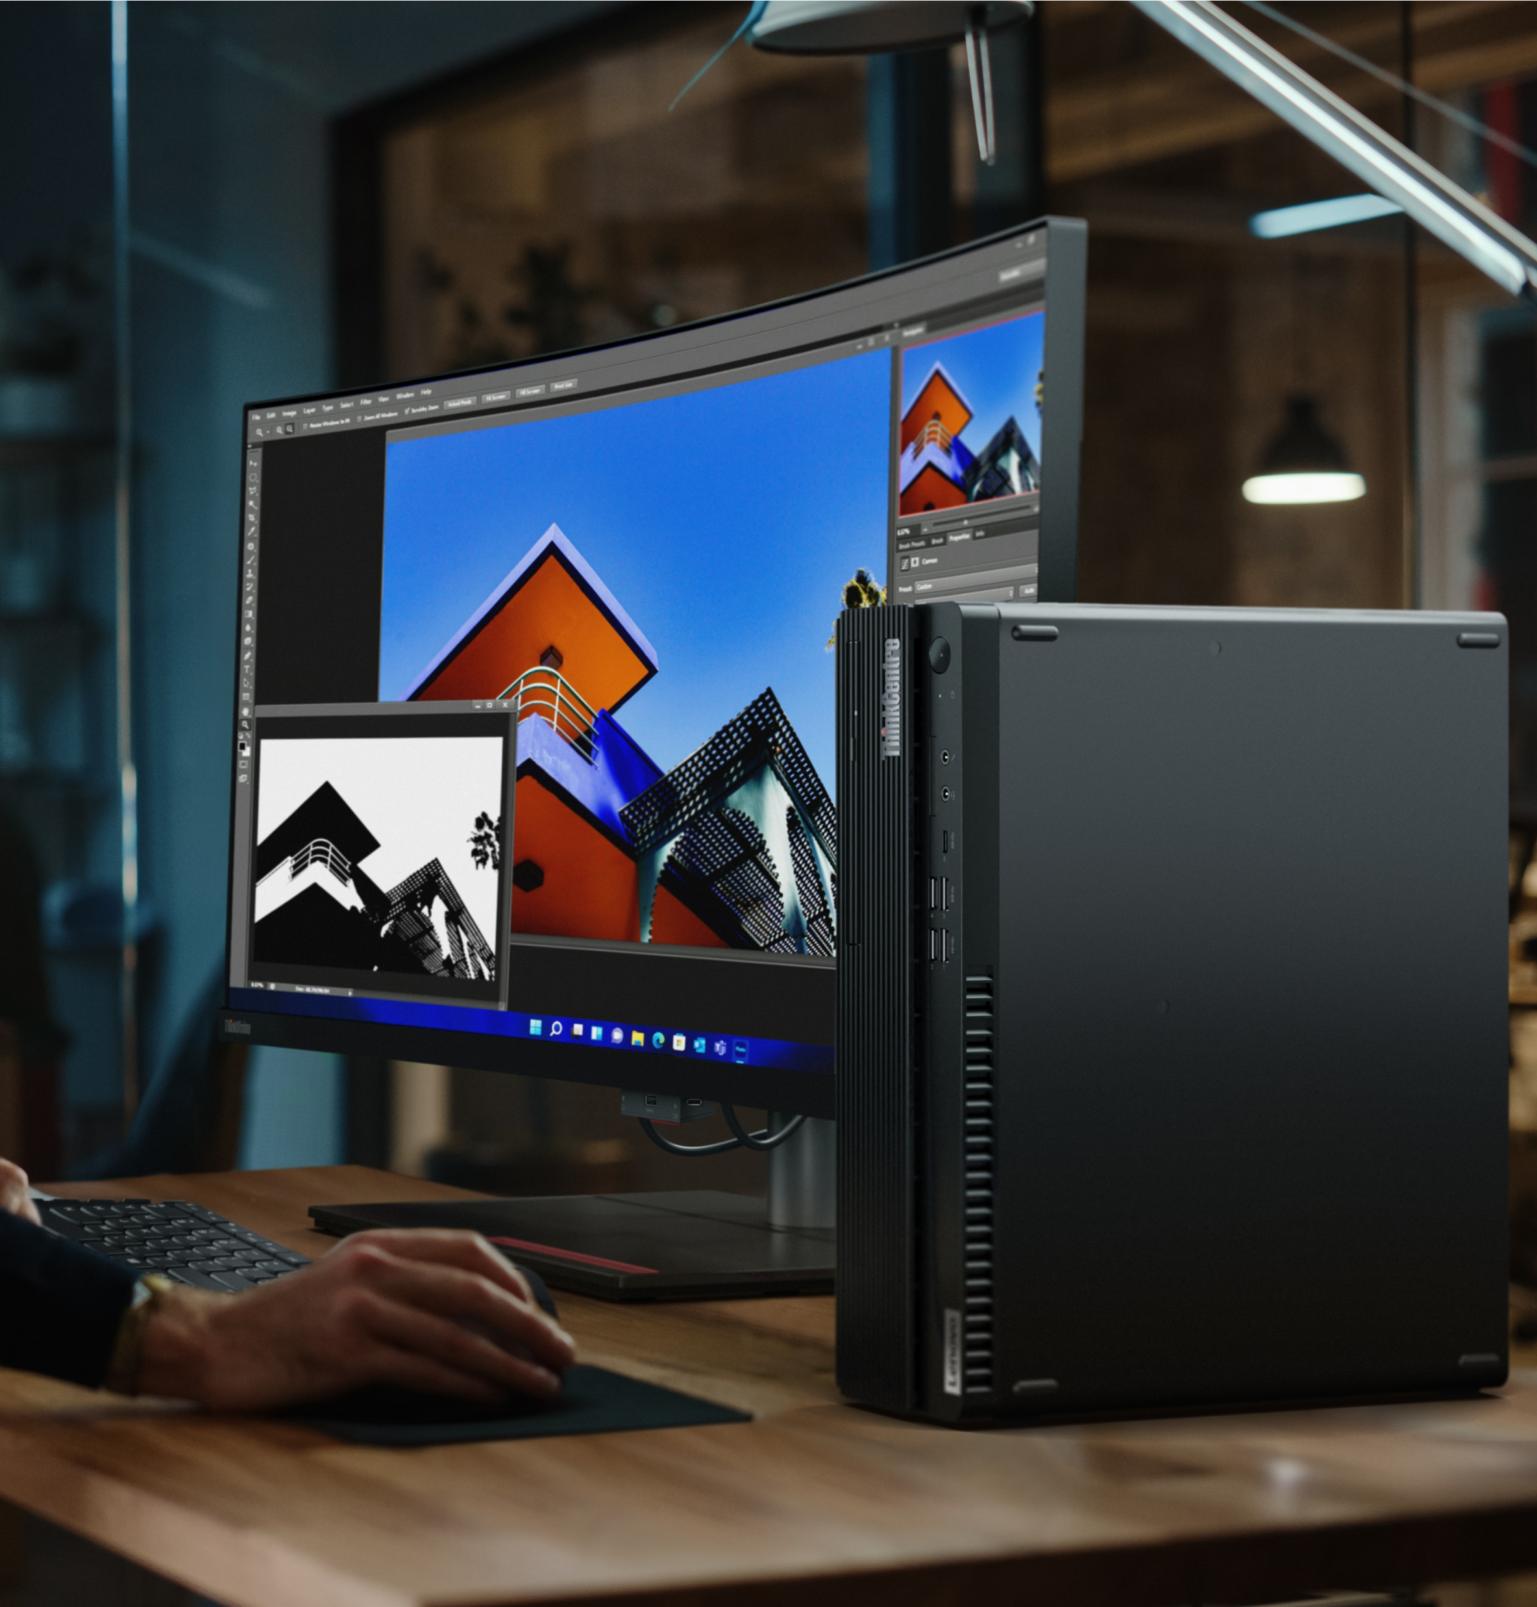
What’s new?
TopSeller model strategy
  WiFi 6E in all models*
  vPro on all i5 models*
  16GB memory baseline*
  Open DIMM on all models*
  DP in optional video port*
  Drop-ship models with 32GB+ memory
  Drop-ship models with discrete GPU
  *where possible

Slide 12
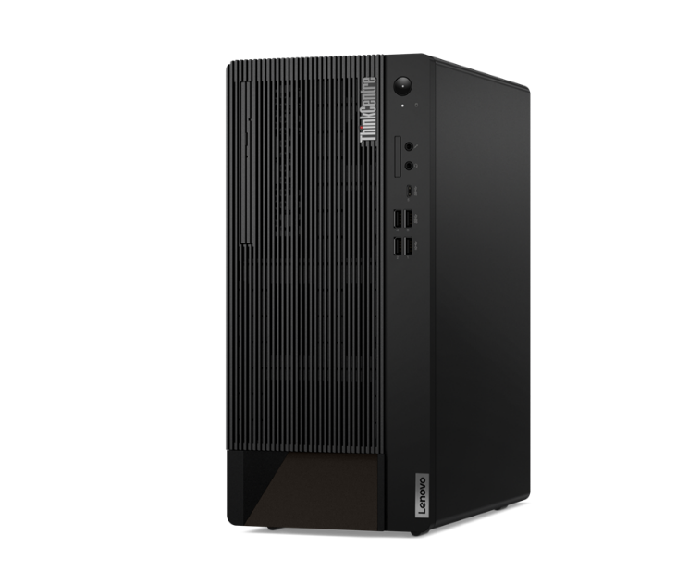
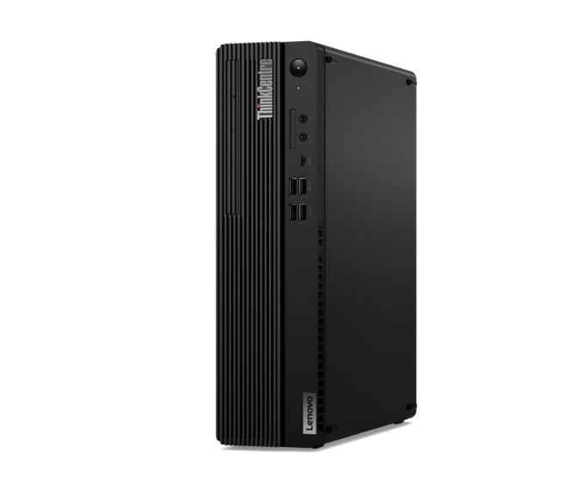
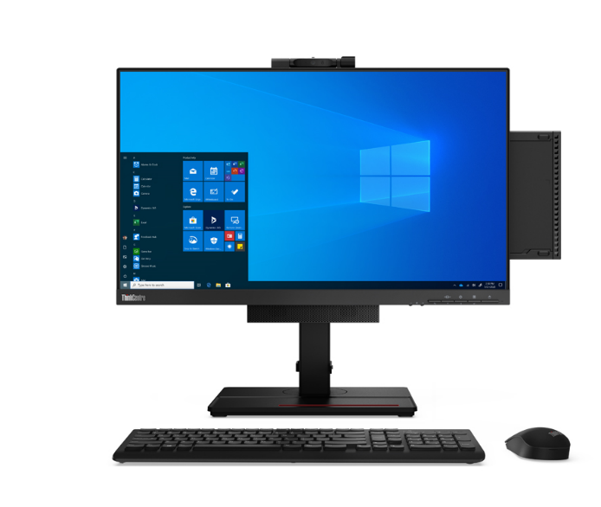
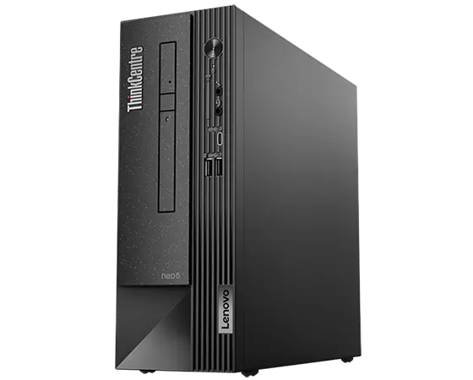
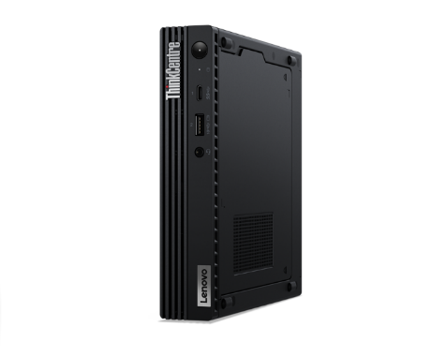
LENOVO TOPSELLER
ThinkCentre & Lenovo Desktops
LENOVO TOPSELLER
ThinkCentre & Lenovo Desktops
[ 1 OF 5 ]
ThinkCentre M75q Gen 2 Tiny (Pictured with optional Tiny-in-One)
ThinkCentre Tower
(M70t/M80t/M90t)
ThinkCentre
Small Form Factor
(M70s/M75s/M80s/M90s)
ThinkCentre Neo Small Form Factor
(Neo50s)
ThinkCentre Tiny
(Neo 50q/M70q/M75q/M80q/M90q)

Slide 13
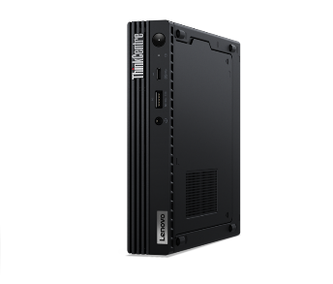
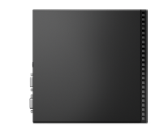
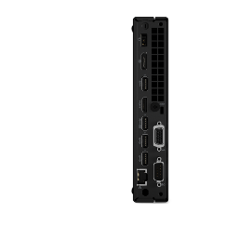
ThinkCentre M series Tiny
Prices shown do not include rebate (if available).
M70q Tiny Gen 5 | $1,149 | $1,339 | $1,369 | $1,699 | $1,899
 | $100 Rebate | $125 Rebate | $125 Rebate | $125 Rebate | $125 Rebate
 | 12TD001MUS/CA | 12TD001UUS/CA | 12TD001RUS/CA | 12TD001KUS/CA | 12TD001SUS/CA
 | Core i3-14100T | Core i5-14400T | Core i5-14400T | Core i7-14700T | Core i7-14700T
 | 1x 16GB SO-DIMM DDR5-4800 | 1x 16GB SO-DIMM DDR5-4800 | 1x 16GB SO-DIMM DDR5-4800 | 1x 16GB SO-DIMM DDR5-5600 | 1x 32GB SO-DIMM DDR5-5600
 | 256GB SSD M.2 PCIe | 256GB SSD M.2 PCIe | 512GB SSD M.2 PCIe | 512GB SSD M.2 PCIe | 1TB SSD M.2 PCIe
 | Win11 Pro 64 | Win11 Pro 64 | Win11 Pro 64 | Win11 Pro 64 | Win 11 Pro 64
 | 3 Year Onsite | 3 Year Onsite | 3 Year Onsite | 3 Year Onsite | 3 Year Onsite
[ 2 OF 3 ]
ThinkCentre Tiny
M90q Tiny Gen 5 | $1,639 | $1,759 | $2,239
 | 12TH000EUS/CA | 12TH000XUS/CA | 12TH0010US/CA
 | Core i5-14500 | Core i5-14500 | Core i7-14700
 | 1x 16GB SO-DIMM DDR5-4800 | 1x 32GB SO-DIMM DDR5-4800 | 1x 32GB SO-DIMM DDR5-5200
 | 512GB SSD M.2 PCIe | 512GB SSD M.2 PCIe | 512GB SSD M.2 PCIe
 | Win11 Pro 64 | Win11 Pro 64 | Win11 Pro 64
 | 3 Year Onsite | 3 Year Onsite | 3 Year Onsite
M75q Tiny G5 | $1,279 | $1,569
 | $225 Rebate | $100 Rebate
 | 12RQ000KUS/CA | 12RQ000MUS/CA
 | AMD Ryzen 5 PRO 8500GE | AMD Ryzen 7 PRO 8700GE
 | 1x 16GB SO-DIMM DDR5-5200 | 1x 16GB SO-DIMM DDR5-5200
 | 512GB SSD M.2 2280 PCIe | 512GB SSD M.2 2280 PCIe
 | Win11 Pro 64 | Win11 Pro 64
 | 3 Year Onsite | 3 Year Onsite

Slide 14
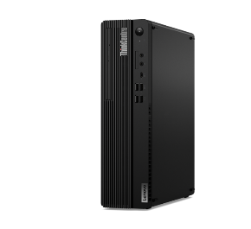
ThinkCentre Small Form Factor Desktops
[ 5 OF 8 ]
Prices shown do not include rebate (if available).
M70s SFF Gen 5 | $1,499 | $1,879
 |  | $50 Rebate
 | 12U3000UUS/CA | 12U3000VUS/CA
 | Core i5-14400 | Core i7-14700
 | 16GB DDR5-4800 | 16GB DDR5-4800
 | 512GB SSD M.2 PCIe | 512GB SSD M.2 PCIe
 | DVD RW | DVD RW
 | 1xDP,1xHDMI | 1xDP,1xHDMI
 | Win11 Pro 64 | Win11 Pro 64
 | 3 Year Onsite | 3 Year Onsite
M90s SFF Gen 5 | $1,769 | $2,199
 | 12V4001BUS/CA | 12V40002US/CA
 | Core i5-14500 | Core i5-12500
 | 2x 8GB UDIMM DDR5-4400 | 2x 8GB UDIMM DDR5-4400
 | 512GB SSD M.2 PCIe | 512GB SSD M.2 PCIe
 | DVD RW | DVD RW
 | 2xDP,1xHDMI | 2xDP,1xHDMI
 | Win11 Pro 64 | Win11 Pro 64
 | 3 Year Onsite | 3 Year Onsite
M75s SFF Gen 2 | $1,189 | $1,499
 |  | $25 Rebate
 | 11R80051US/CA | 11R8004GUS/CA
 | Ryzen 5 PRO 5650G | AMD Ryzen 7 PRO 5750G
 | 1x 16GB UDIMM DDR4-3200 | 1x 16GB UDIMM DDR4-3200
 | 256GB SSD M.2 PCIe | 512GB SSD M.2 PCIe
 | DVD RW | DVD RW
 | 2xDP,1xHDMI | 2xDP,1xHDMI
 | Win11 Pro 64 | Win11 Pro 64
 | 3 Year Onsite | 3 Year Onsite
ThinkCentre M90s SFF
Neo 50s Gen4 | $1,049 | $1,109
 | $25 Rebate | $25 Rebate
 | 12JF0000US/CA | 12JF0002US/CA
 | Intel Core i5-13400 | Intel Core i5-13400
 | 1x 8GB DDR4-3200 | 1x 16GB DDR4-3200
 | 256GB SSD M.2 2280 PCIe GEN4 | 256GB SSD M.2 2280 PCIe GEN4
 | 1x DP, 1x HDMI, 1x VGA | 1x DP, 1x HDMI, 1x VGA
 | Intel 6 AX201, 802.11ax 2x2 + BT5.1 | Intel 6 AX201, 802.11ax 2x2 + BT5.1
 | Win 11 Pro 64 | Win 11 Pro 64
 | 1-year, Onsite | 1-year, Onsite
Neo 50s Gen5 | $1,149 | $1,179
 | 12XF000VUS/CA | 12XF000WUS/CA
 | Intel Core i5-14400 | Intel Core i5-14400
 | 1x 16GB DDR5-5600 | 1x 16GB DDR5-5600
 | 256GB SSD M.2 2280 PCIe GEN4 | 512GB SSD M.2 2280 PCIe GEN4
 | 1x DP, 1x HDMI, 1x VGA | 1x DP, 1x HDMI, 1x VGA
 | Intel 6 AX211, 802.11ax 2x2 + BT5.1 | Intel 6 AX211, 802.11ax 2x2 + BT5.1
 | Win 11 Pro 64 | Win 11 Pro 64
 | 1-year, Onsite | 1-year, Onsite
ThinkCentre Neo Small Form Factor
(Neo50s)

Slide 15
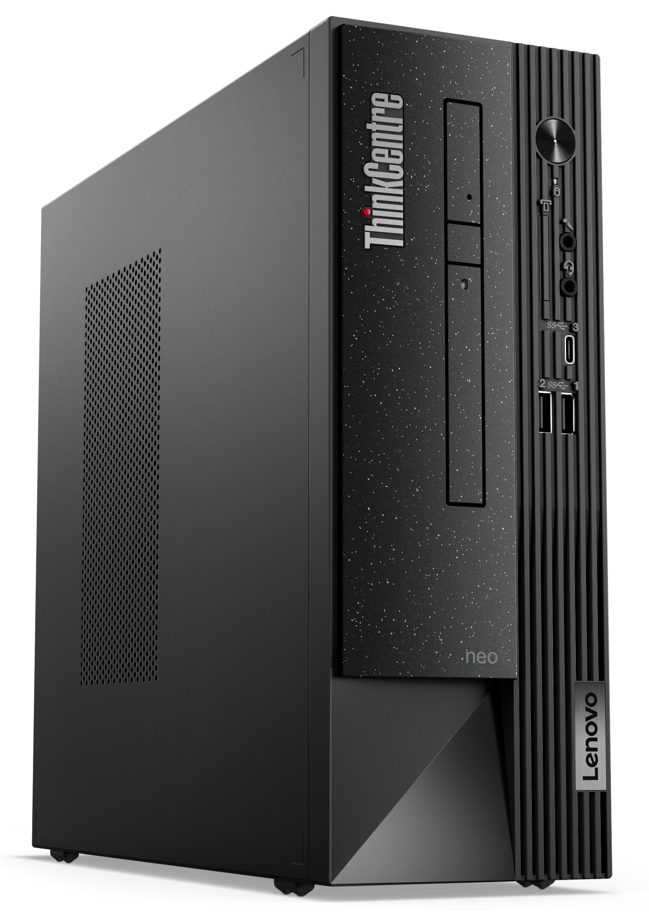
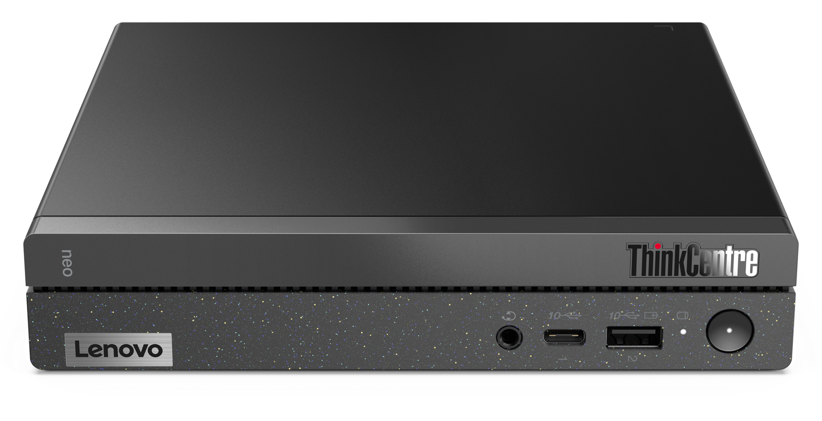
ThinkCentre neo Tiny & SFF
Neo 50q Gen4 | $1,019 | $1,119
 | $125 Rebate | $125 Rebate
 | 12LN000CUS/CA | 12LN000BUS/CA
 | Intel Core i5-13420H | Intel Core i5-13420H
 | 1x 8GB DDR4-3200 | 1x 16GB DDR4-3200
 | 256GB SSD M.2 2280 PCle GEN4 | 256GB SSD M.2 2280 PCIe GEN4
 | 2x DP, 1x HDMI | 2x DP, 1x HDMI
 | Intel 6 AX201, 802.11ax 2x2 + BT5.2 | Intel 6 AX201, 802.11ax 2x2 + BT5.2
 | Win 11 Pro 64 | Win 11 Pro 64
 | 1-year, Onsite | 1-year, Onsite
Neo 50s Gen4 | $1,049 | $1,109
 | $25 Rebate | $25 Rebate
 | 12JF0000US/CA | 12JF0002US/CA
 | Intel Core i5-13400 | Intel Core i5-13400
 | 1x 8GB DDR4-3200 | 1x 16GB DDR4-3200
 | 256GB SSD M.2 2280 PCIe GEN4 | 256GB SSD M.2 2280 PCIe GEN4
 | 1x DP, 1x HDMI, 1x VGA | 1x DP, 1x HDMI, 1x VGA
 | Intel 6 AX201, 802.11ax 2x2 + BT5.1 | Intel 6 AX201, 802.11ax 2x2 + BT5.1
 | Win 11 Pro 64 | Win 11 Pro 64
 | 1-year, Onsite | 1-year, Onsite
Neo 50s Gen5 | $1,149 | $1,179
 | 12XF000VUS/CA | 12XF000WUS/CA
 | Intel Core i5-14400 | Intel Core i5-14400
 | 1x 16GB DDR5-5600 | 1x 16GB DDR5-5600
 | 256GB SSD M.2 2280 PCIe GEN4 | 512GB SSD M.2 2280 PCIe GEN4
 | 1x DP, 1x HDMI, 1x VGA | 1x DP, 1x HDMI, 1x VGA
 | Intel 6 AX211, 802.11ax 2x2 + BT5.1 | Intel 6 AX211, 802.11ax 2x2 + BT5.1
 | Win 11 Pro 64 | Win 11 Pro 64
 | 1-year, Onsite | 1-year, Onsite

Slide 16
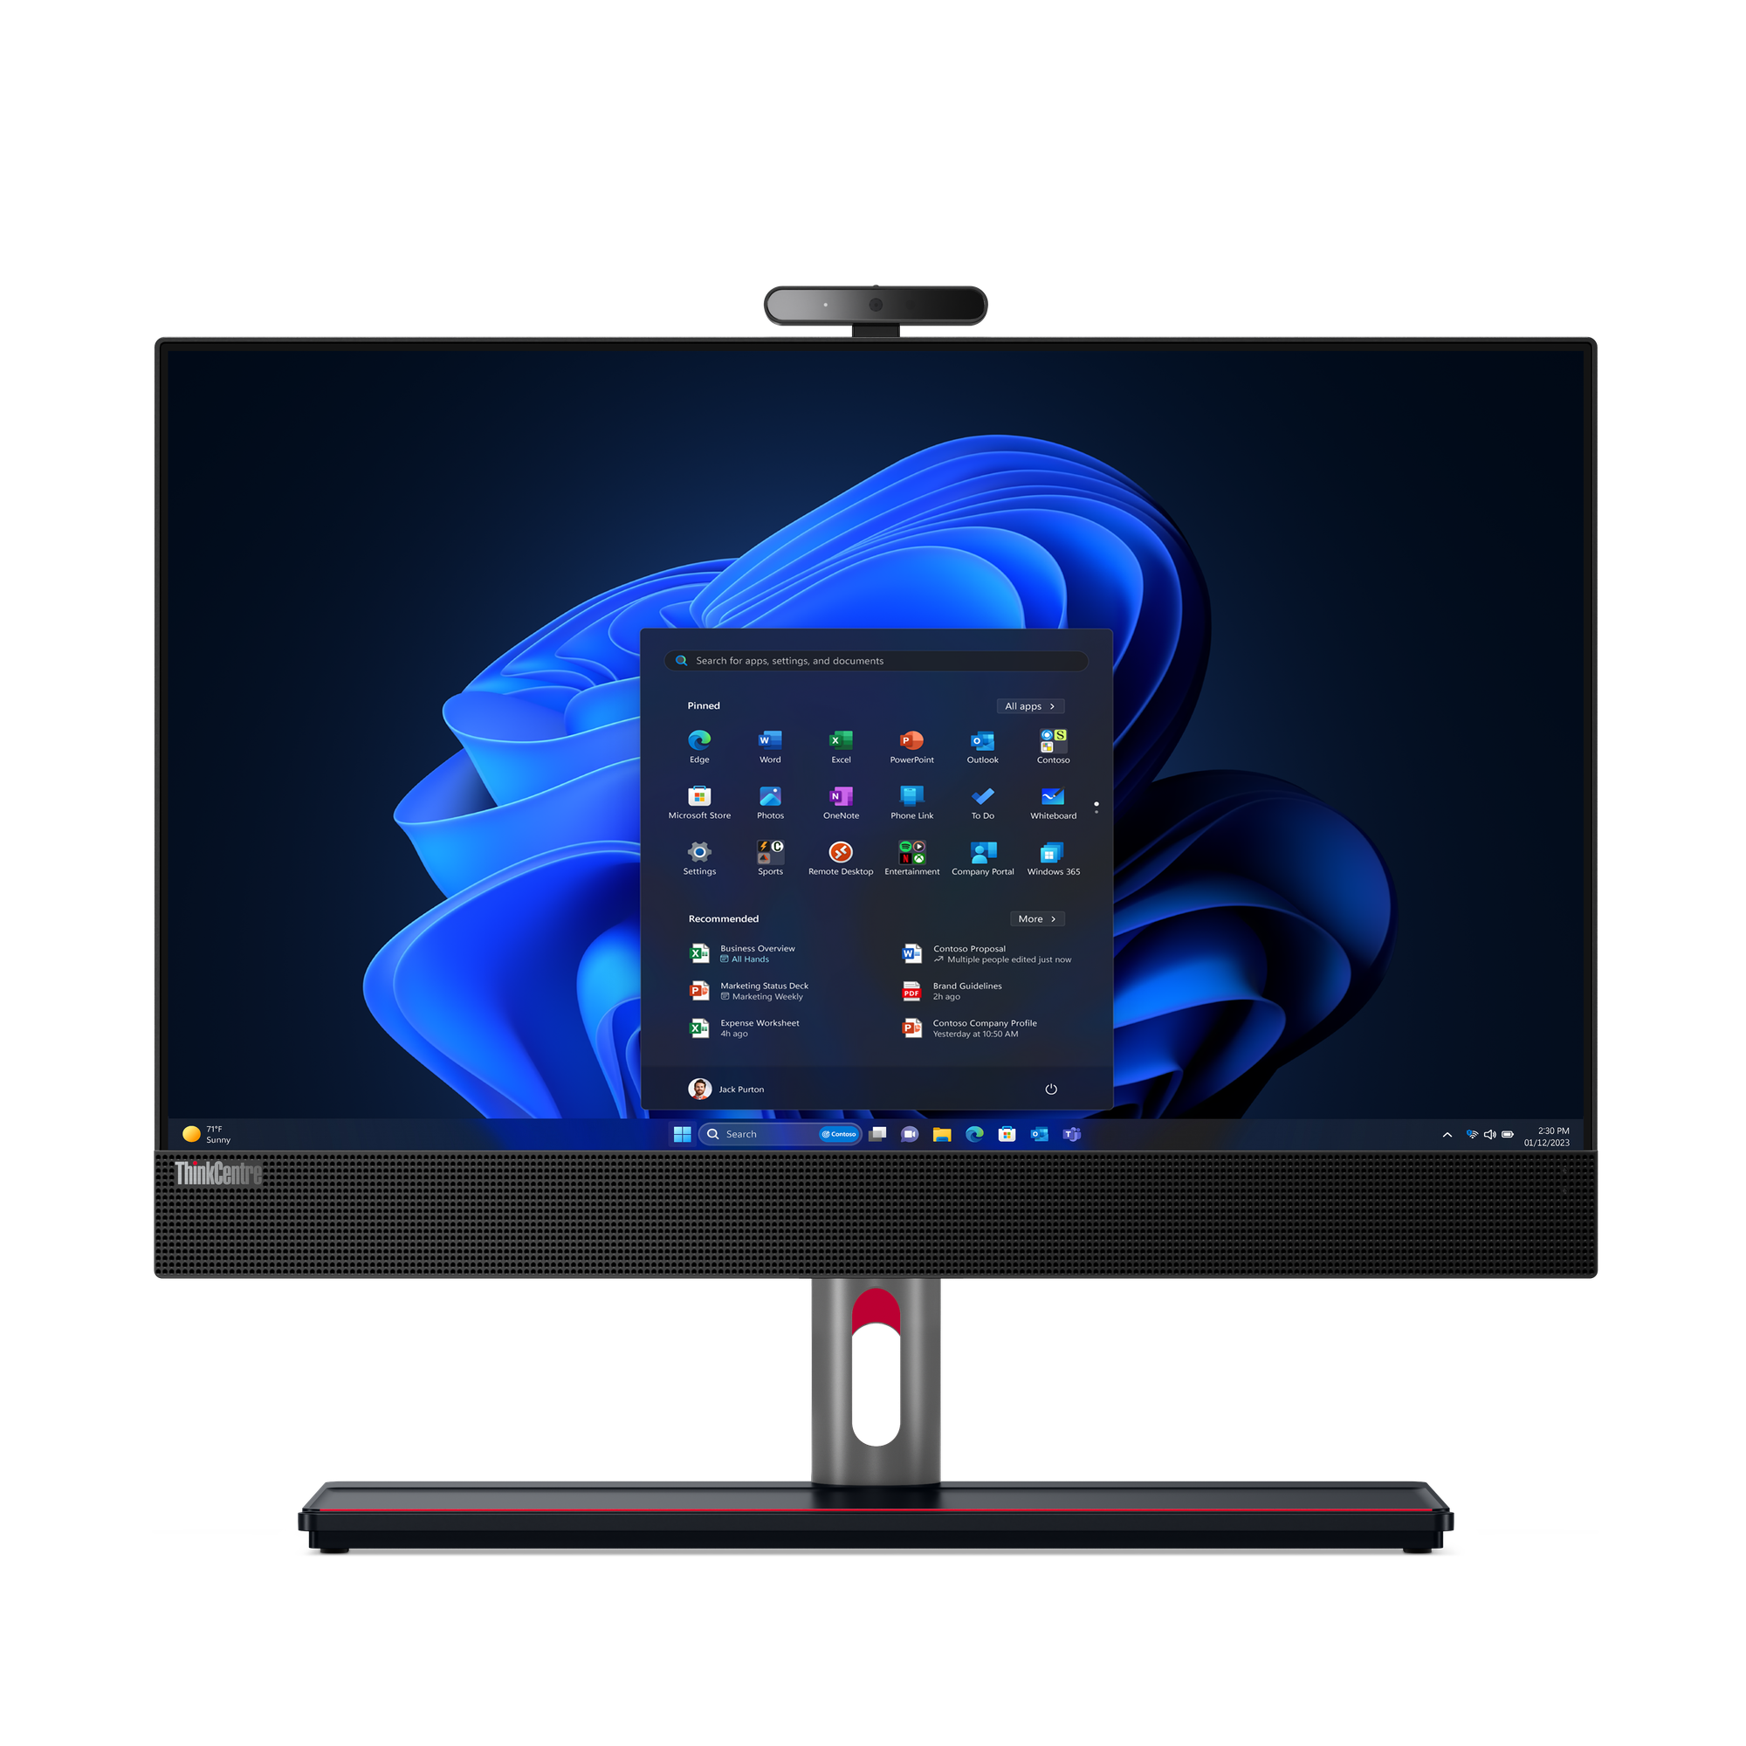
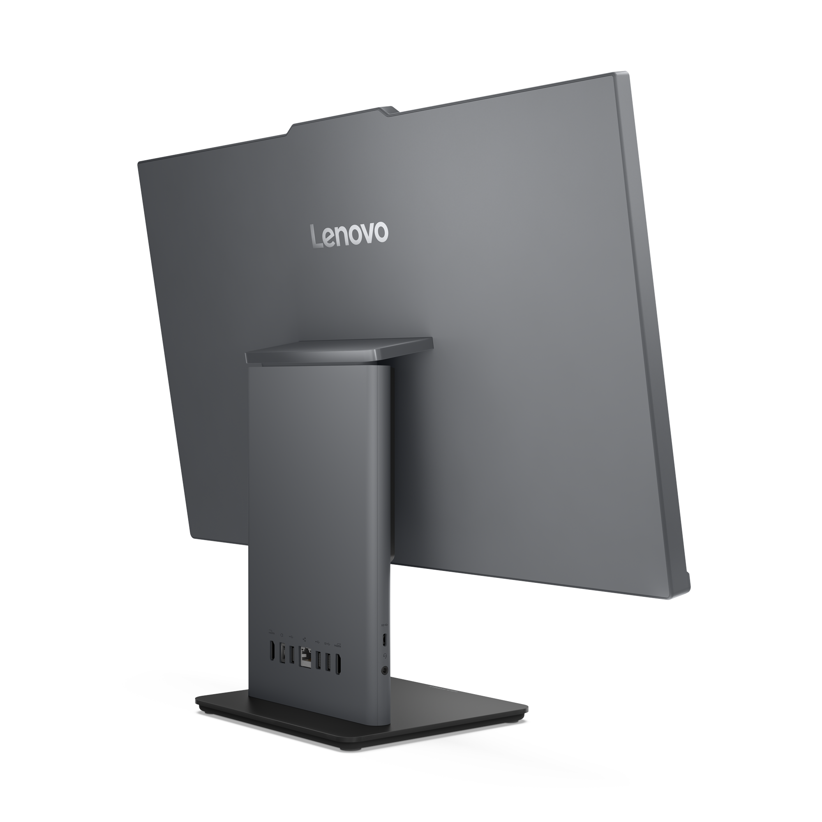
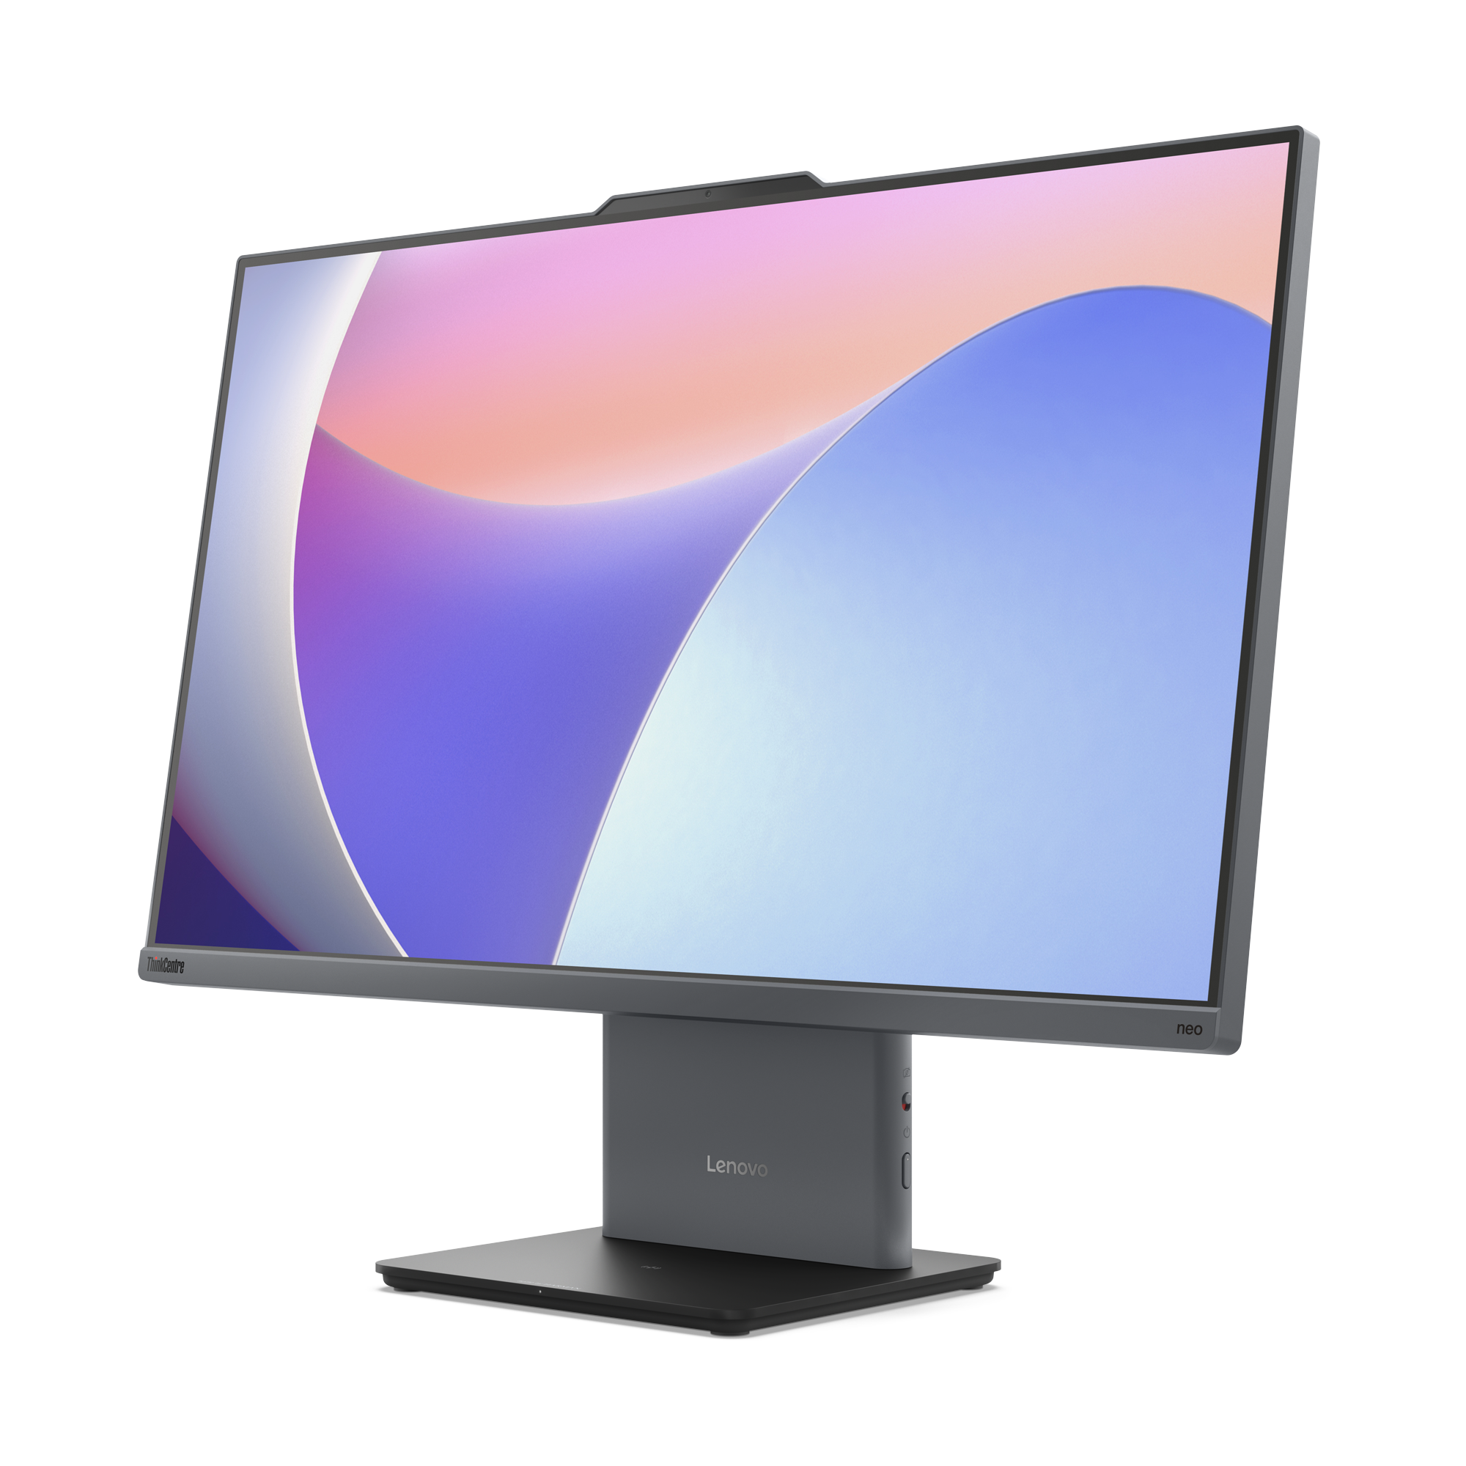
ThinkCentre AIO, non-touch
Neo 50a AIO 24” | $1,179 | $1,309
 | 12SD004AUS/CA | 12SD004LUS/CA
 | Intel Core i5-13420H | Intel Core i5-13620H
 | 1x 16GB DDR5-5200 | 1x 16GB DDR5-5200
 | 512GB SSD M.2 2280 PCle | 512GB SSD M.2 2280 PCle
 | 1x HDMI-in 1.4 1x HDMI-out 2.1 TMDS | 1x HDMI-in 1.4 1x HDMI-out 2.1 TMDS
 | Intel 6 AX201, 802.11ax 2x2 + BT5.2 | Intel 6 AX201, 802.11ax 2x2 + BT5.2
 | Win 11 Pro 64 | Win 11 Pro 64
 | 1-year, Onsite | 1-year, Onsite
Neo 50a AIO 27” | $1, 219 | $1,349
 | 12SB003GUS/CA | 12SB003SUS/CA
 | Intel Core i5-13420H | Intel Core i5-13620H
 | 1x 16GB DDR5-5200 | 1x 16GB DDR5-5200
 | 512GB SSD M.2 2280 PCle | 512GB SSD M.2 2280 PCle
 | 1x HDMI-in 1.4 1x HDMI-out 2.1 TMDS | 1x HDMI-in 1.4 1x HDMI-out 2.1 TMDS
 | Intel 6 AX201, 802.11ax 2x2 + BT5.1 | Intel 6 AX201, 802.11ax 2x2 + BT5.1
 | Win 11 Pro 64 | Win 11 Pro 64
 | 1-year, Onsite | 1-year, Onsite
M90a G5 AIO 24” | $2,069
 | 12SH001MUS/CA
 | Core i5-14500
 | 1x16GB DDR5-4800
 | 256GB SSD M.2 PCIe NVMe Opal
 | 1x HDMI 1x DisplayPort 1.4
 | Intel Wi-Fi 6E AX211
 | Win11 Pro 64
 | 3-year, Onsite

Slide 17
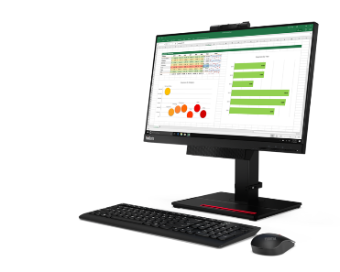


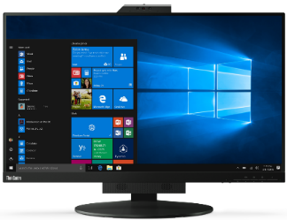

ThinkVision Monitors
[ 8 OF 8 ]
Prices shown do not include rebate (if available).
ThinkCentre Tiny-in-One 27
TINY-IN-ONE 4
Price is Monitor Only.
ThinkCentre Tiny (Pictured) Sold Separately
Tiny-in-One 22 Monitor | $389
 | 12N8GAR1US
 | 21.5”
 | 1080p Non-Touch Display
 | 1080p Webcam w/ Mic
 | 1 x USB 3.2 / 1x USB-B 3.2
 | Tiny PC Compatibility (AIO Mode)
 | DisplayPort / HMDI In (Monitor Mode)
 | Lift / Tilt / Pivot Stand Adjustment
 | 3 Year Adv. Exchange Warranty
Tiny-in-One 22 Touch Monitor | $469
 | 12N9GAR1US
 | 21.5”
 | 1080p Touch Display
 | 1080p Webcam w/ Mic
 | 1 x USB 3.2 / 1x USB-B 3.2
 | Tiny PC Compatibility (AIO Mode)
 | DisplayPort / HMDI In (Monitor Mode)
 | Lift / Tilt / Pivot Stand Adjustment
 | 3 Year Adv. Exchange Warranty
Tiny-in-One 24 Touch Monitor | $509
 | 12NBGAR1US
 | 23.8”
 | 1080p Touch Display
 | 1080p Webcam w/ Mic
 | 1 x USB 3.2 / 1x USB-B 3.2
 | Tiny PC Compatibility (AIO Mode)
 | DisplayPort / HMDI In (Monitor Mode)
 | Lift / Tilt / Pivot Stand Adjustment
 | 3 Year Adv. Exchange Warranty
Tiny-in-One 27 Monitor | $619
 | 11JHRAR1US
 | 27” WLED Borderless Panel
 | 1440p Non-Touch Display
 | 1080p Webcam w/ Mic
 | 2 x USB 3.1 port (when Tiny inside)
 | Tiny PC Compatibility (AIO Mode)
 | DisplayPort / HMDI In (Monitor Mode)
 | Lift / Tilt / Pivot Stand Adjustment
 | 3 Year Adv. Exchange Warranty

Slide 18
Mobile Workstations & ThinkStation
June 2024

Slide 19
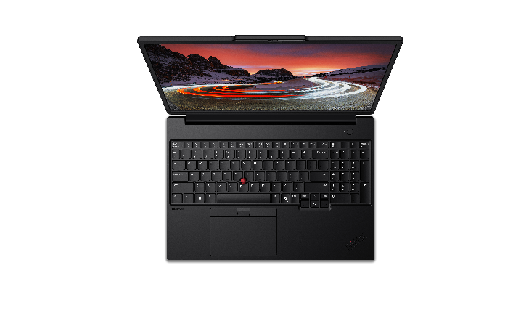
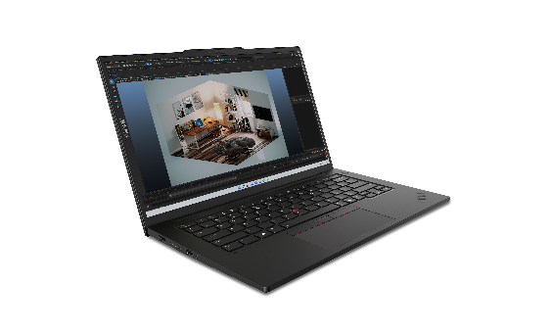
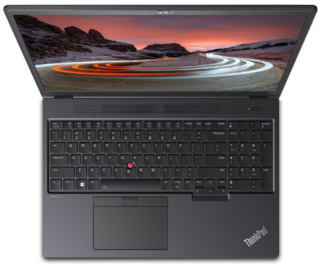
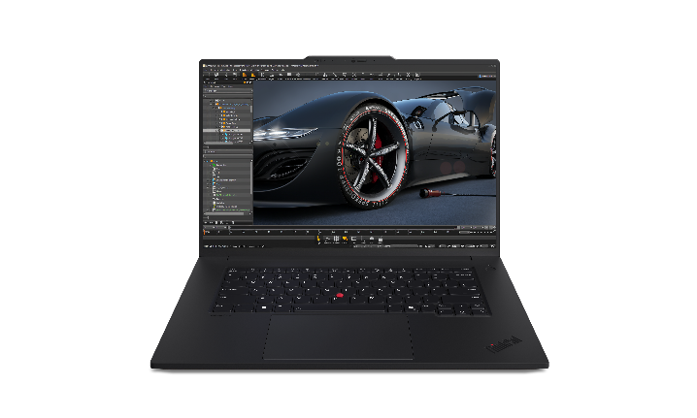
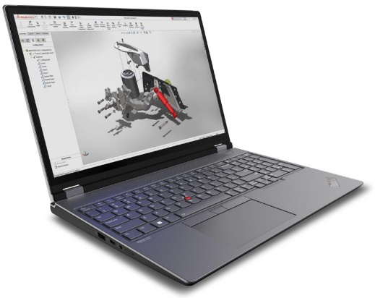
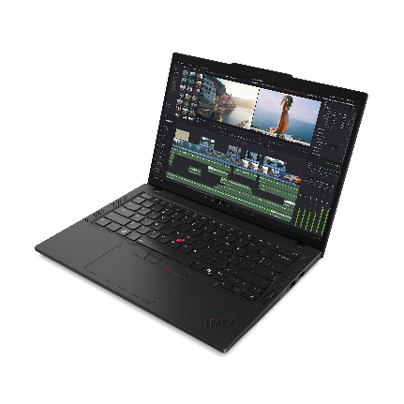
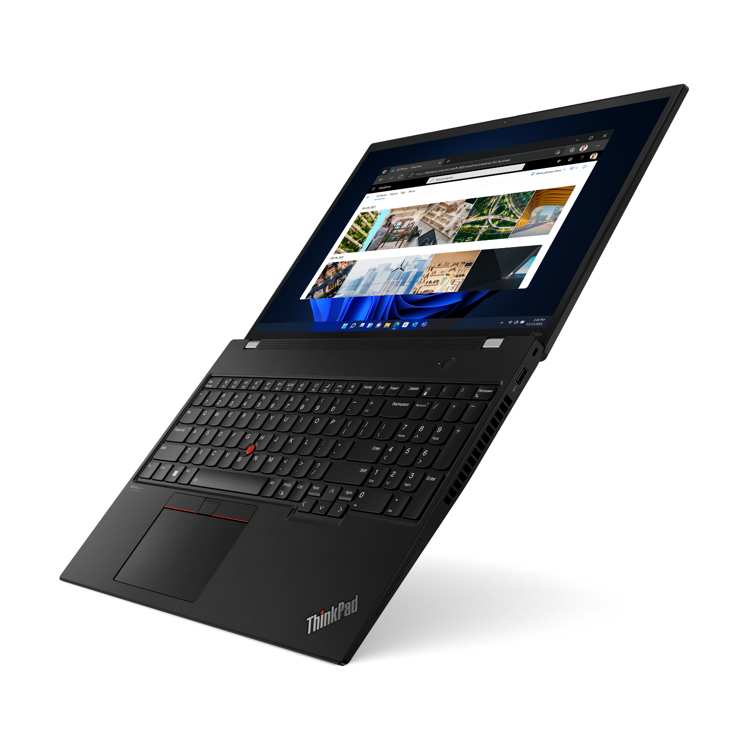


Lenovo Topseller ThinkPad Mobile Workstations
P16s Gen3 Intel
P14s Gen5 Intel
P14s Gen5 AMD
P16s Gen2 AMD
ThinkPad P14s Intel
ThinkPad P14s AMD
Ultra-portable 14-inch
with all-day battery
ThinkPad P16s Intel
ThinkPad P16s AMD
Thin & light 16-inch with all-day battery
ThinkPad P16v Intel
ThinkPad P16v AMD
Value 16-inch performance Mobile Workstation
NVIDIA professional graphics
ThinkPad P1
Ultra-premium 16-inch*
Now even more performance up to NVIDIA RTX 5000 Ada graphics
ThinkPad P16
Ultra-Performance 16-inch
Intel HX CPUs with
up to NVIDIA RTX 5000 Ada graphics

Slide 20
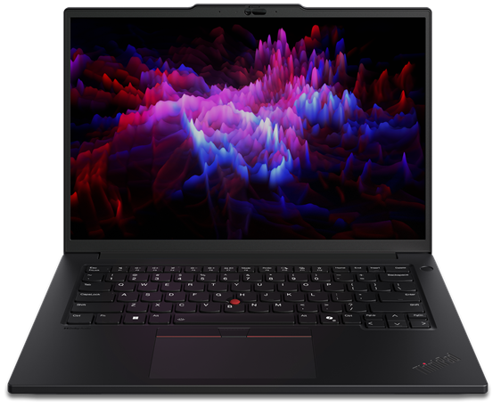
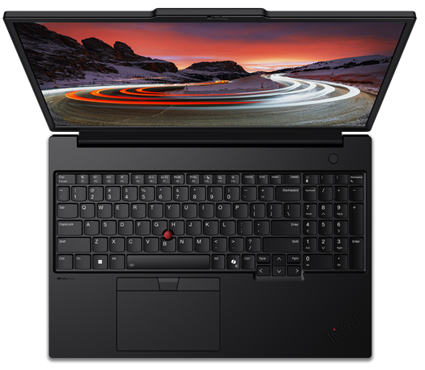
Lenovo Topseller ThinkPad Mobile Workstations
P14s Gen 5 & P16s Gen 3 Intel | Ultraportable performance
P14s Gen 5 14” Ultra-portable | $2,449 | $2,589 | $2,779 | $2,979 | $3,349 | $3,659
 | $250 Rebate | $250 Rebate |  | $350 Rebate | $250 Rebate | $450 Rebate
 | 21G2001UUS/CA | 21G2001MUS/CA | 21G2001SUS/CA | 21G20022US/CA | 21G2001VUS/CA | 21G2001PUS/CA
 | Ultra 5 125H | Ultra 7 155H | Ultra 7 155H | Ultra 7 155H | Ultra 7 155H | Ultra 7 165H
 | 1x 16GB | 1x 16GB | 2x 16GB | 1x 16GB | 2x 16GB | 2x 16GB
 | 512GB SSD M.2 | 512GB SSD M.2 | 512GB SSD M.2 | 512GB SSD M.2 | 1TB SSD M.2 | 1TB SSD M.2
 | Intel Graphics | Intel Graphics | Intel Graphics | NVIDIA RTX 500 Ada 4GB | NVIDIA RTX 500 Ada 4GB | NVIDIA RTX 500 Ada 4GB
 | 14.5" WUXGA (1920x1200) | 14.5" WUXGA (1920x1200) | 14.5" WUXGA (1920x1200) | 14.5" WQXGA (2560x1600) | 14.5" WUXGA (1920x1200) | 14.5" WQXGA (2560x1600)
 | 5.0MP + IR, BT, Backlit KYB, aluminum | 5.0MP + IR, BT, Backlit KYB, aluminum | 5.0MP + IR, BT, Backlit KYB, aluminum | 5.0MP + IR, BT, Backlit KYB, aluminum | 5.0MP + IR, BT, Backlit KYB, aluminum | 5.0MP + IR, BT, Backlit KYB, aluminum
 | Integrated 75Wh Battery | Integrated 75Wh Battery | Integrated 75Wh Battery | Integrated 75Wh Battery | Integrated 75Wh Battery | Integrated 75Wh Battery
 | Win11 Pro | Win11 Pro | Win11 Pro | Win11 Pro | Win11 Pro | Win11 Pro
 | 3 Year Depot | 3 Year Depot | 3 Year Depot | 3 Year Depot | 3 Year Depot | 3 Year Depot
P16s Gen 3 16” Ultra-portable | $2,659 | $2,859 | $2,979 | $3,079 | $3,429 | $3,639
 | $350 Rebate | $350 Rebate | $475 Rebate | $250 Rebate | $475 Rebate | $250 Rebate
 | 21KS001HUS/CA | 21KS0043US/CA | 21KS001MUS/CA | 21KS0023US/CA | 21KS0027US/CA | 21KS0026US/CA
 | Ultra 7 155H | Ultra 7 165H | Ultra 7 155H | Ultra 7 155H | Ultra 7 155H | Ultra 7 165H
 | 1x 16GB | 1x 16GB | 1x 16GB | 1x 16GB | 2x 16GB | 2x 16GB
 | 512GB SSD M.2 | 512GB SSD M.2 | 512GB SSD M.2 | 512GB SSD M.2 | 1TB SSD M.2 | 1TB SSD M.2
 | Intel Graphics | Intel Graphics | NVIDIA RTX 500 Ada 4GB | NVIDIA RTX 500 Ada 4GB | NVIDIA RTX 500 Ada 4GB | NVIDIA RTX 500 Ada 4GB
 | 16" WUXGA (1920x1200) | 16" WUXGA (1920x1200) | 16" WUXGA (1920x1200) | 16" WUXGA (1920x1200) Touch | 16" WUXGA (1920x1200) | 16" WUXGA (1920x1200)
 | 5.0MP + IR, BT, Backlit KYB, aluminum | 5.0MP + IR, BT, Backlit KYB, aluminum | 5.0MP + IR, BT, Backlit KYB, aluminum | 5.0MP + IR, BT, Backlit KYB, aluminum | 5.0MP + IR, BT, Backlit KYB, aluminum | 5.0MP + IR, BT, Backlit KYB, aluminum
 | Integrated 75Wh Battery | Integrated 75Wh Battery | Integrated 75Wh Battery | Integrated 75Wh Battery | Integrated 75Wh Battery | Integrated 75Wh Battery
 | Win11 Pro | Win11 Pro | Win11 Pro | Win11 Pro | Win11 Pro | Win11 Pro
 | 3 Year Depot | 3 Year Depot | 3 Year Depot | 3 Year Depot | 3 Year Depot | 3 Year Depot

Slide 21
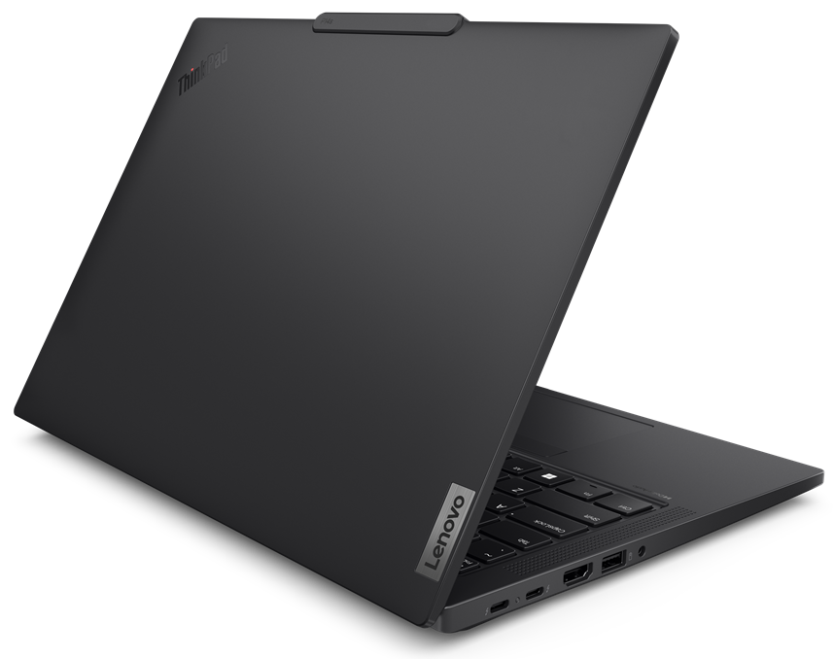
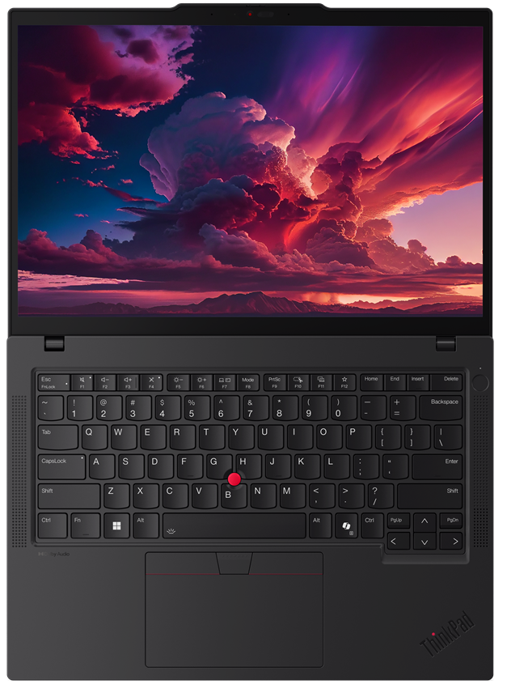
Lenovo Topseller ThinkPad AMD Mobile Workstations
P14s AMD Gen 5 | $1,799 | $2,129 | $2,349
 | $100 Rebate | $100 Rebate | $100 Rebate
 | 21ME001CUS/CA | 21ME0019US/CA | 21ME001EUS/CA
 | Ryzen 7 Pro 8840HS | Ryzen 7 Pro 8840HS | Ryzen 7 Pro 8840HS
 | 2x 16GB | 1x 16GB | 2x 16GB
 | 512GB PCIe SSD | 512GB PCIe SSD | 1TB PCIe SSD
 | Integrated AMD Radeon 780M | Integrated AMD Radeon 780M | Integrated AMD Radeon 780M
 | 14” 16:10 WUXGA (FHD+) IPS touch | 14” 16:10 WUXGA (FHD+) IPS | 14” 16:10 WUXGA (FHD+) IPS
 | 5MP-IR Camera | 5MP | 5MP
 | Win 11 Pro 64 | Win 11 Pro 64 | Win 11 Pro 64
 | 3 Year Premier Support | 3 Year Premier Support | 3 Year Premier Support
P16s AMD G2 | $2,159 | $2,379
 | 21K9003AUS/CA | 21K9003BUS/CA
 | AMD Ryzen 7 PRO 7840U | AMD Ryzen 7 PRO 7840U
 | 1x 16GB | 1x 32GB
 | 512GB PCIe SSD | 1TB PCIe SSD
 | Integrated AMD Radeon 780M | Integrated AMD Radeon 780M
 | 16" WUXGA (1920x1200) | 16" WUXGA (1920x1200)
 | 5MP-IR Camera | 5MP-IR Camera
 | Win 11 Pro 64 | Win 11 Pro 64
 | 3 Year Premier Support/Sealed Batt | 3 Year Premier Support/Sealed Batt
P16V AMD G1 | $2,879 | $3,139
 | $300 Rebate | $300 Rebate
 | 21FE0027US/CA | 21FE0028US/CA
 | AMD Ryzen 7 PRO 7840HS | AMD Ryzen 7 PRO 7840HS
 | 1x 16GB | 1x 32GB
 | 512GB PCIe SSD | 1TB PCIe SSD
 | NVIDIA RTX A1000 6GB | NVIDIA RTX A1000 6GB
 | 16" WUXGA (1920x1200) | 16" WUXGA (1920x1200)
 | 5MP-IR Camera | 5MP-IR Camera
 | Win 11 Pro 64 | Win 11 Pro 64
 | 3 Year Premier Support/Sealed Batt | 3 Year Premier Support/Sealed Batt

Slide 22
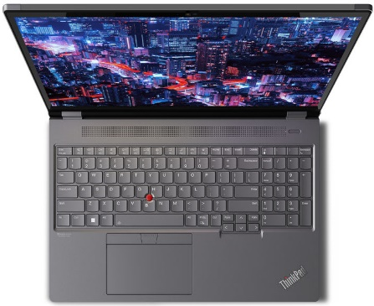
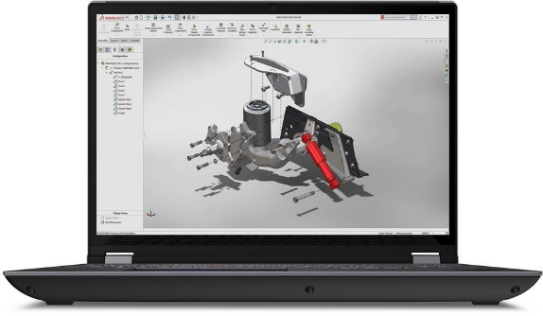

Lenovo Topseller ThinkPad Mobile Workstations
P16 | The Most Powerful ThinkPad Ever
LENOVO TOPSELLER
ThinkPad Mobile Workstations
[ 3 OF 8 ]
P16 G2 | $3,769 | $4,519 | $4,949 | $5,759
 | $300 Rebate | $950 Rebate | $250 Rebate | $450 Rebate
 | 21FA0032US/CA | 21FA002TUS/CA | 21FA002NUS/CA | 21FA002XUS/CA
 | Core i7-13700HX 16C | Core i7-13700HX 16C | Core i9-13950HX 24C vPro | Core i7-13700HX 16C
 | 16GB DDR5 4000 | 32GB DDR5 4000 | 32GB DDR5 4000 | 32GB DDR5 4000
 | 512GB PCIe SSD | 1TB PCIe SSD | 1TB PCIe SSD | 1TB PCIe SSD
 | NVIDIA RTX A1000 6GB | NVIDIA RTX 2000 8GB | NVIDIA RTX 2000 8GB | NVIDIA RTX 4000 12GB
 | 16” 16:10 WQXGA (QHD+) IR Cam | 16” 16:10 WQXGA (QHD+) IR Cam | 16” 16:10 WQXGA (QHD+) IR Cam | 16” 16:10 WQXGA (QHD+) IR Cam
 | Win 11 Pro 64 | Win 11 Pro 64 | Win 11 Pro 64 | Win 11 Pro 64
 | 3yr Premier Support | 3yr Premier Support | 3yr Premier Support | 3yr Premier Support

Slide 23



Lenovo Topseller ThinkPad Mobile Workstations
P16v Gen 2 (Intel only) Value of Performance
P16v G2 | $3,149 | $3,459 | $3,889 | $5,129
 | $350 Rebate | $350 Rebate | $350 Rebate | $350 Rebate
 | 21KX001VUS/CA | 21KX0021US/CA | 21KX002EUS/CA | 21KX002GUS/CA
 | Core Ultra 7 155H | Core Ultra 7 155H | Core Ultra 7 165H vPro | Core Ultra 9 185H vPro
 | 16GB DDR5 5600 | 16GB DDR5 5600 | 32GB DDR5 5600 | 32GB DDR5 5600
 | 512GB PCIe SSD | 512GB PCIe SSD | 1TB PCIe SSD | 1TB PCIe SSD
 | NVIDIA RTX 500 4GB | NVIDIA RTX 1000 6GB | NVIDIA RTX 1000 6GB | NVIDIA RTX 3000 8GB
 | 16” 16:10 WUXGA (FHD+) IPS | 16” 16:10 WUXGA (FHD+) IPS | 16” 16:10 WUXGA (FHD+) IPS | 16” 16:10 WUXGA (FHD+) IPS
 | 5MP-IR Camera | 5MP-IR Camera | 5MP-IR Camera | 5MP-IR Camera
 | Win 11 Pro 64 | Win 11 Pro 64 | Win 11 Pro 64 | Win 11 Pro 64
 | 3yr Premier Support | 3yr Premier Support | 3yr Premier Support | 3yr Premier Support

Slide 24


Lenovo Topseller ThinkPad Mobile Workstations
P1 | The Machine You Need in the Device You Want
P1 G7 | $3,799 | $4,589 | $4,749 | $5,139 | $5,819
 | $250 Rebate | $250 Rebate | $250 Rebate | $250 Rebate | $250 Rebate
 | 21KV0003US/CA | 21KV0000US/CA | 21KV000PUS/CA | 21KV0001US/CA | 21KV000AUS/CA
 | Core Ultra 7 155H | Core Ultra 7 155H | Core Ultra 7 155H | Core Ultra 9 185H vPro | Core Ultra 7 165H vPro
 | 1x 16GB | 1x 32GB | 1x 32GB | 1x 32GB | 64 GB
 | 512GB SSD M.2 | 1TB SSD M.2 | 1TB SSD M.2 | 1TB SSD M.2 | 2TB SSD M.2
 | NVIDIA RTX 1000 6GB | NVIDIA RTX 2000 8GB | NVIDIA RTX 1000 6GB | NVIDIA GeForce RTX 4070 8GB | NVIDIA RTX 2000 8GB
 | 16" WUXGA (1920x1200) IPS | 16" WUXGA (1920x1200) IPS | 16" WQUXGA (3840x2400) Touch | 16" WUXGA (1920x1200) IPS | 16" WQUXGA (3840x2400) Touch
 | Win 11 Pro 64 | Win 11 Pro 64 | Win 11 Pro 64 | Win 11 Pro 64 | Win 11 Pro 64
 | 3yr Premier Support | 3yr Premier Support | 3yr Premier Support | 3yr Premier Support | 3yr Premier Support

Slide 25


Lenovo Topseller ThinkStation Desktop Workstations
PX
WORLD’S MOST ADVANCED DUAL SOCKET PERFORMANCE WORKSTATION
P5
EXPERT SINGLE SOCKET WORKSTATION
P7
ADVANCED AND VERSATILE SUPER SOCKET TOWER
P8
NEXT-LEVEL THREADRIPPER PRO PERFORMANCE
P3 Ultra
REDEFIGNING THE POWER OF SMALL
P3 Tower
POWER OF A WORKSTATION,
PRICE OF A
DESKTOP
P3 Tiny
WORLD’S SMALLEST WORKSTATION
P620
THE ORIGINAL THREADRIPPER PRO LEADER

Slide 26



Lenovo Topseller ThinkStation Desktop Workstations
P3 Tiny: World’s Smallest Professional Desktop Workstation
Now available with Intel 13th Gen Core Performance
Latest Intel pro processing power
Memory speeds up to 4800 GHz
Full power 65W CPUs now available with NVIDIA professional graphics
Ideal for engineering education & entry CAD/CAM users
P3 Tiny | $2,189 | $2,369 | $2,449 | $3,079 | $3,309
 | $250 Rebate | $250 Rebate | $250 Rebate | $250 Rebate | $250 Rebate
 | 30H00072US | 30H0006YUS | 30H0006LUS | 30H0006TUS | 30H0006VUS
 | Core i7-14700 | Core i7-14700 | Core i7-14700 | Core i9-14900 | Core i9-14900
 | 1x 16GB | 1x 32GB | 1x 16GB | 1x 32GB | 1x 16GB
 | 512GB SSD M.2 | 1TB SSD M.2 | 512GB SSD M.2 | 1TB SSD M.2 | 512GB SSD M.2
 | Intel integrated graphics | Intel integrated graphics | Intel integrated graphics | Intel integrated graphics | Intel integrated graphics
 | Win 11 Pro | Win 11 Pro | Win 11 Pro | Win 11 Pro | Win 11 Pro
 | 3 Year Onsite | 3 Year Onsite | 3 Year Onsite | 3 Year Onsite | 3 Year Onsite
Prices shown do not include rebate (if available).
Monitor, DVD-R drive & vertical floor stand sold separately

Slide 27





Lenovo Topseller ThinkStation Desktop Workstations
P3 Ultra SFF: Advanced Small Form Factor Tower Workstation
Configure at:
P3 Ultra | $2,759 | $3,969 | $4,029 | $4,429
 | $250 Rebate | $250 Rebate | $250 Rebate | $250 Rebate
 | 30HA0064US | 30HA0066US | 30HA005XUS | 30HA005WUS
 | Core i7-14700 | Core i9-14900 | Core i7-14700 | Core i9-14900
 | 1x 16GB | 1x 32GB | 1x 32GB | 1x 32GB
 | 512GB SSD M.2 | 1TB SSD M.2 | 1TB SSD M.2 | 1TB SSD M.2
 | Intel integrated graphics | Intel integrated graphics | Intel integrated graphics | Intel integrated graphics
 | Win 11 Pro | Win 11 Pro | Win 11 Pro | Win 11 Pro
 | 3 Year Onsite | 3 Year Onsite | 3 Year Onsite | 3 Year Onsite
Prices shown do not include rebate (if available).

Slide 28



Lenovo Topseller ThinkStation Desktop Workstations
P5 Mainstream Professional Tower Desktop Workstation
ThinkStation P5
All-new Intel Sapphire Rapids architecture with hyper-fast memory and future-proofed PCIe Gen5 readiness
Uniquely ThinkStation, best-of-breed EXPERT performance for Digital Artists, Engineers, Life Scientists & Software Developers
Configure at:
P5 | $3,969 | $5,239 | $7,159
 | $350 Rebate | $400 Rebate | $500 Rebate
 | 30GA005QUS | 30GA004MUS | 30GA005TUS
 | Intel Xeon W-2423 | Intel Xeon W-2425 | Intel Xeon W-2435
 | 32GB DDR5 ECC | 32GB DDR5 ECC | 64GB DDR5 ECC
 | 1TB M.2 PCle | 1TB M.2 PCle | 2TB M.2 PCle
 | NVIDIA T400 4GB | NVIDIA T1000 8GB | NVIDIA RTX A2000 12GB
 | Win 11 Pro | Win 11 Pro | Win 11 Pro
 | 3 Year Onsite Premier | 3 Year Onsite Premier | 3 Year Onsite Premier
Prices shown do not include rebate (if available).

Slide 29



Lenovo Topseller ThinkStation Desktop Workstations
P620 Advanced Performance Tower Workstations
ThinkStation P620
Uniquely ThinkStation, best-of-breed pro performance ideal for Digital Artists, Engineers, Life Scientists & Software Developers
The pioneer for AMD Ryzen Threadripper PRO with 5000-Series CPUs
P620 Workstation | $4,739 | $6,869
 | $600 Rebate | $1250 Rebate
 | 30E000M9US | 30E000MRUS
 | AMD Ryzen3 Threadripper PRO 5945WX 12C/24T | AMD Ryzen3 Threadripper PRO 5955WX 16C/32T
 | 1000W PSU | 1000W PSU
 | 32GB DDR4 ECC (2x16GB) RAM | 64GB DDR4 ECC RAM
 | 1TB M.2 PCle Gen4 SSD | 2TB M.2 PCle Gen4 SSD
 | NVIDIA T400 4GB 3x mDP | NVIDIA RTX A2000 12 GB 4x mDP
 | 15-in-1 Card Reader | 15-in-1 Card Reader
 | Marvell 10GbE | Marvell 10GbE
 | Windows 11 Pro | Windows 11 Pro
 | 3 Year Premier Support | 3 Year Premier Support
Configure at:
Prices shown do not include rebate (if available).

